Slide 1



Step by Step Guide as a School Administrator for the Basic Education Management System (BEMIS) Application

Slide 2
Logging in through the Web Application
PART ONE

Slide 3
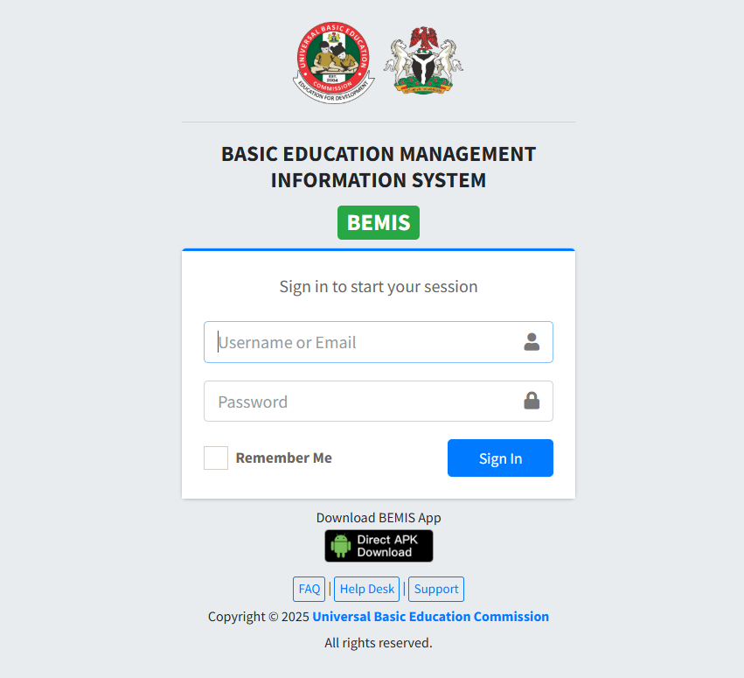

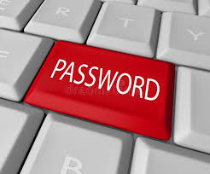
Open any browser of your choice and go to the link bemis.ubecedata.com
Then login using the school’s code and password

Slide 4
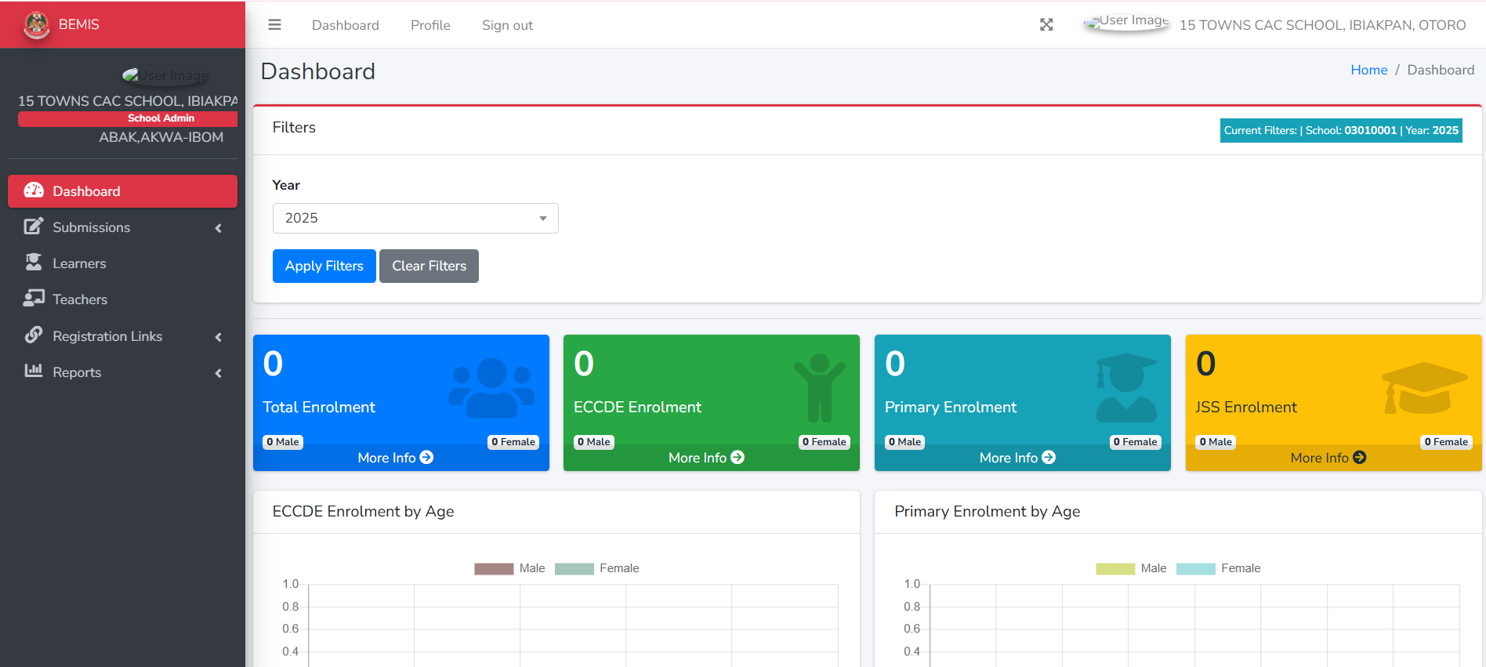
After successfully logging in, you will see a similar picture of the Dashboard displayed.

Slide 5
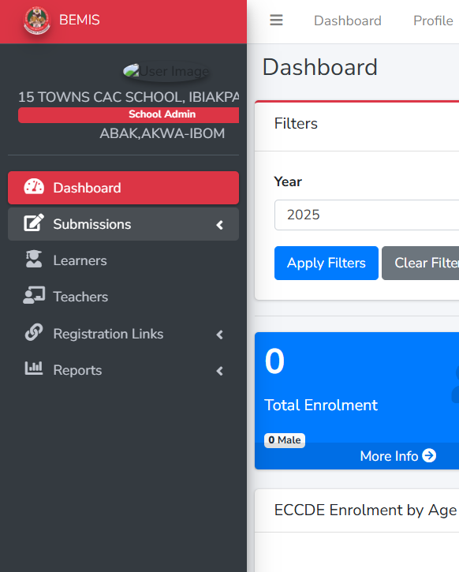
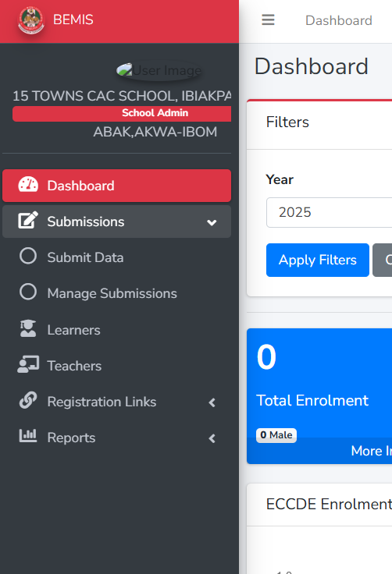
SUBMISSIONS
On the Web App, you can ‘Submit Data’ and ‘Manage Submissions’ from the sidebar to the right by clicking ‘Submissions’.

Slide 6
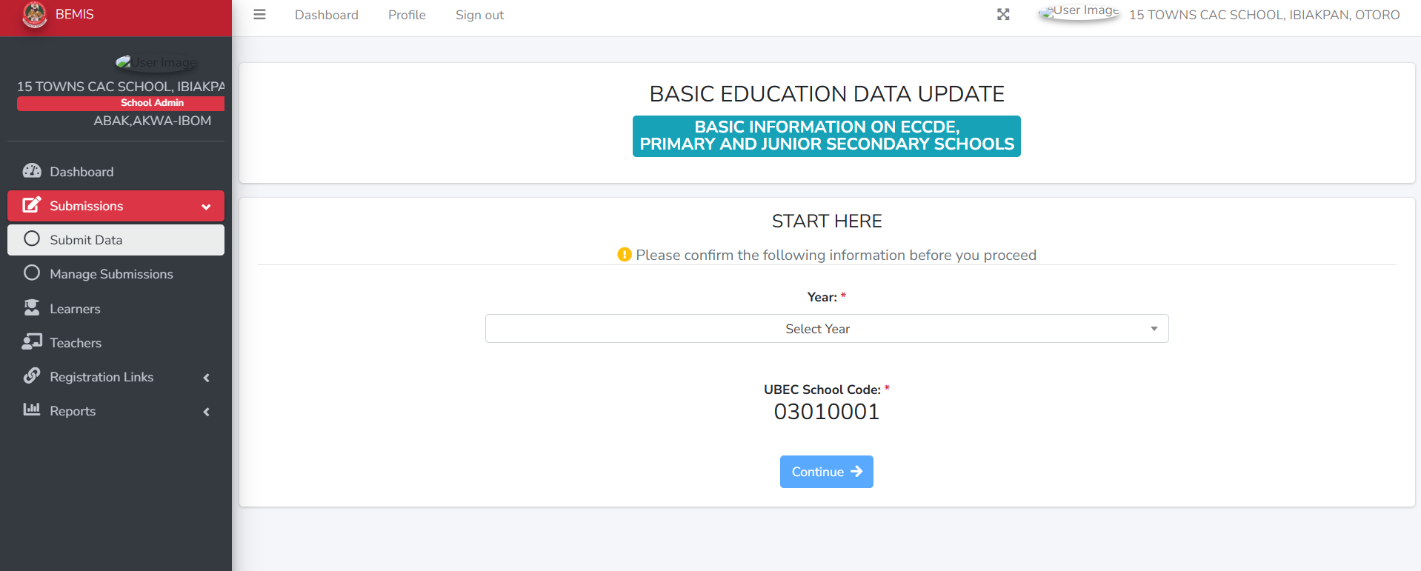
To Submit New School Record
Click on ‘Submissions’
Then click on ‘Submit Data’
Select the ‘Academic Year’
Then click ‘Continue’

Slide 7
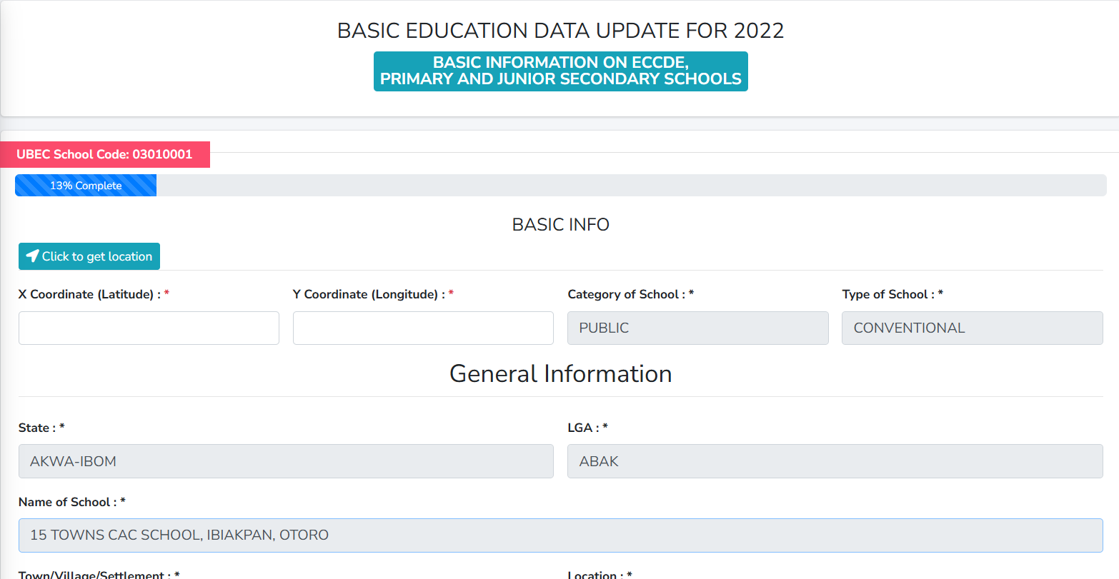
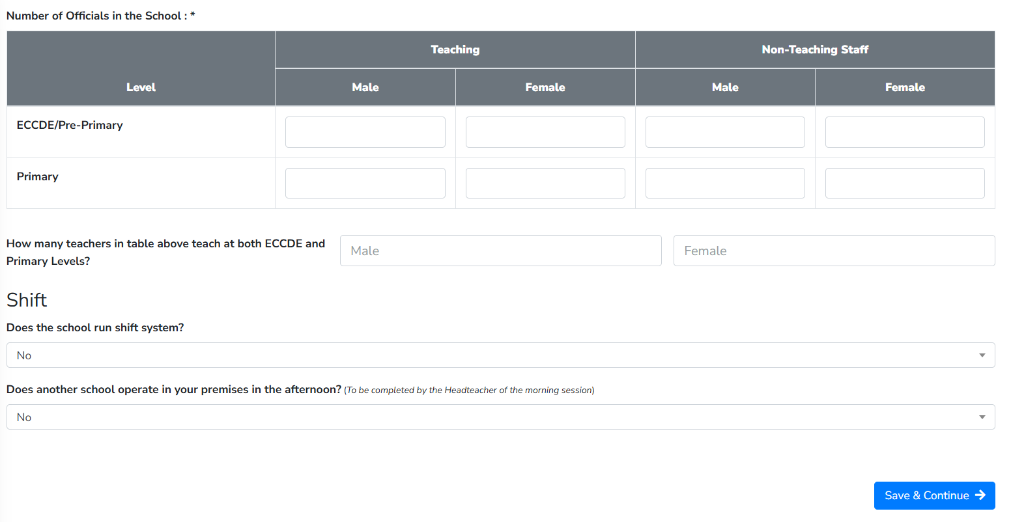
Kindly correctly fill the information for the school to update the school record.

Slide 8
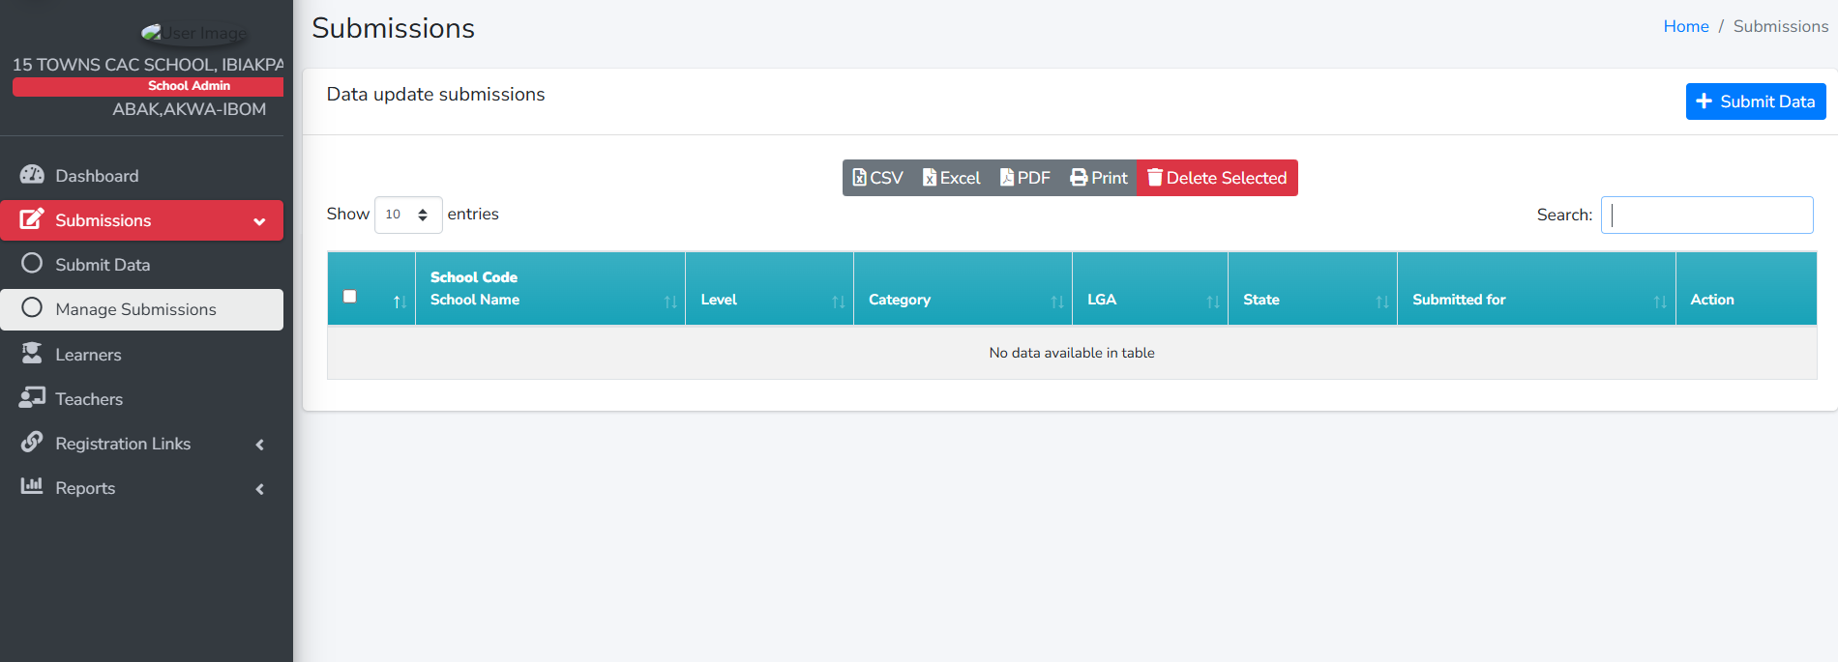
To Manage/Update School Record
Click on ‘Submissions’
Then click on ‘Manage Submissions’
Select the record you want to update from the available data in the table.
Then make your corrections and save.

Slide 9
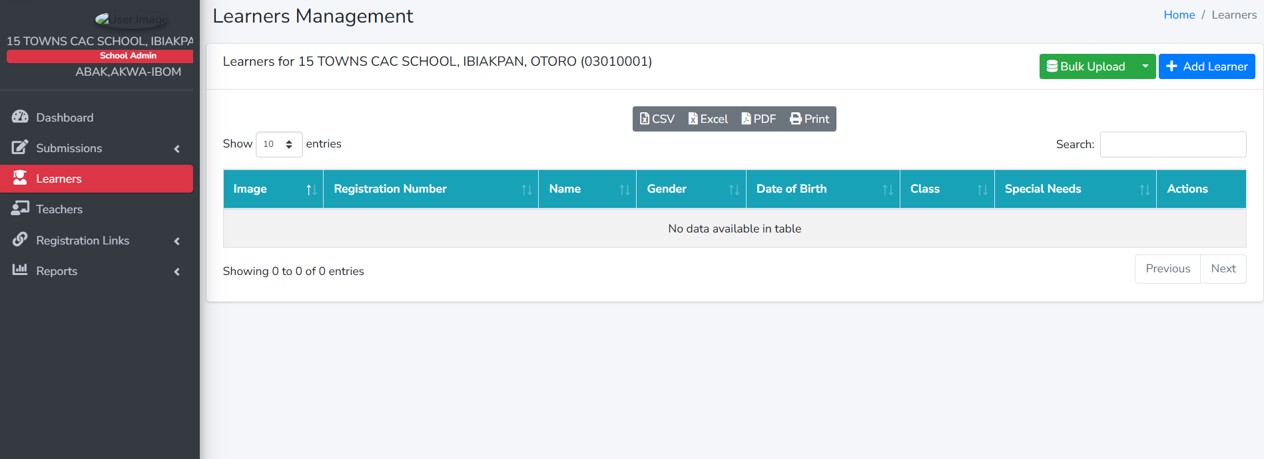
Learners Management
Addition of Learners: Learners can be added individually or through bulk upload.

Slide 10
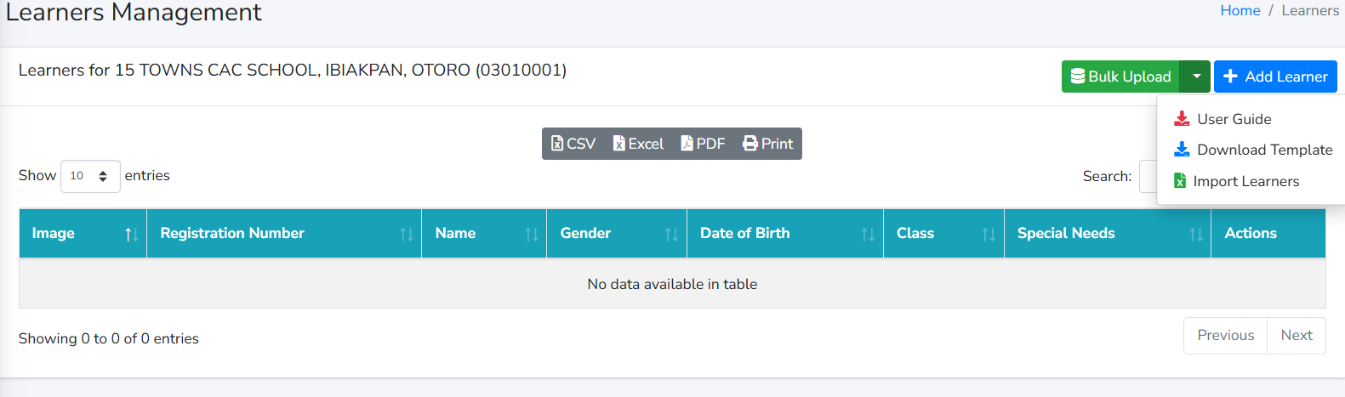
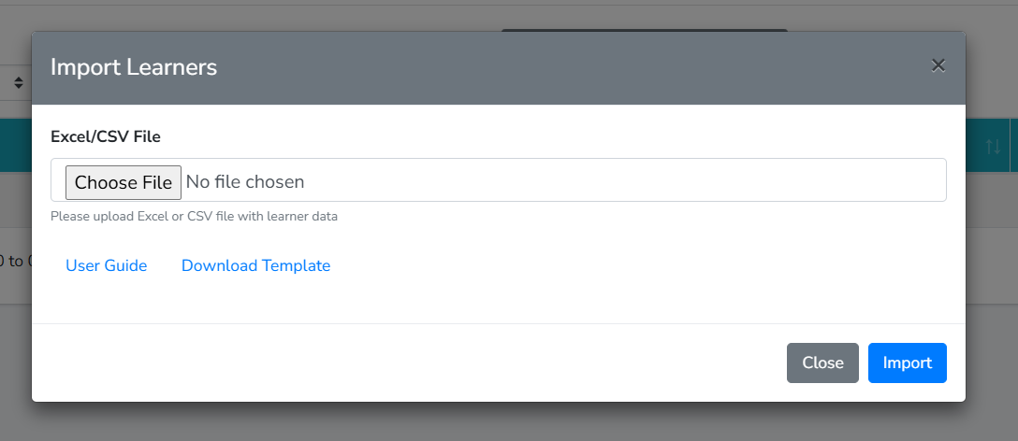
To bulk upload Learners’ information:
Click ‘Bulk Upload’
Go through the ‘User Guide’ for the guideline required in filling the Template.
Click ‘Download Template’ to download the template for the bulk upload.
After carefully populating the Template in line with the User Gude, click ‘Import Learners’ to upload the completed template.

Slide 11
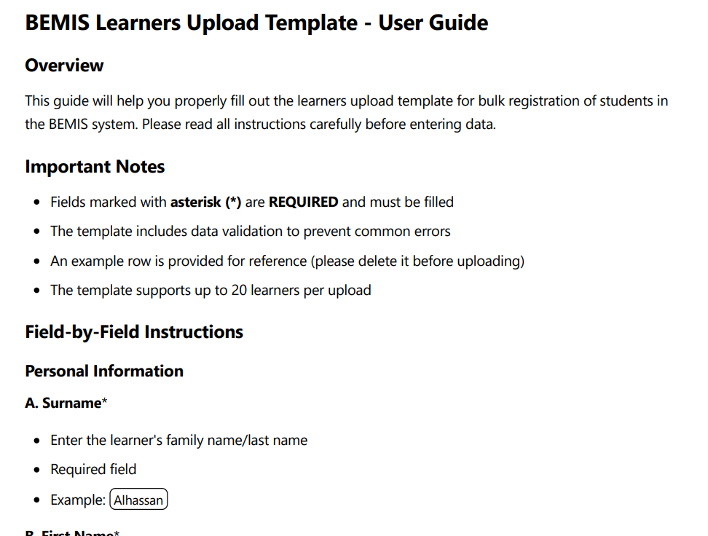
A snapshot of the User Guide for filling the Template for Bulk Upload

Slide 12
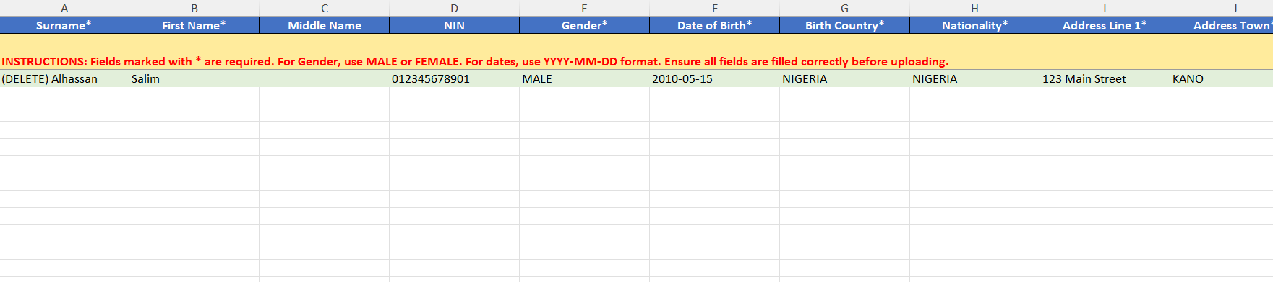
A snapshot of the Template for Bulk Upload

Slide 13
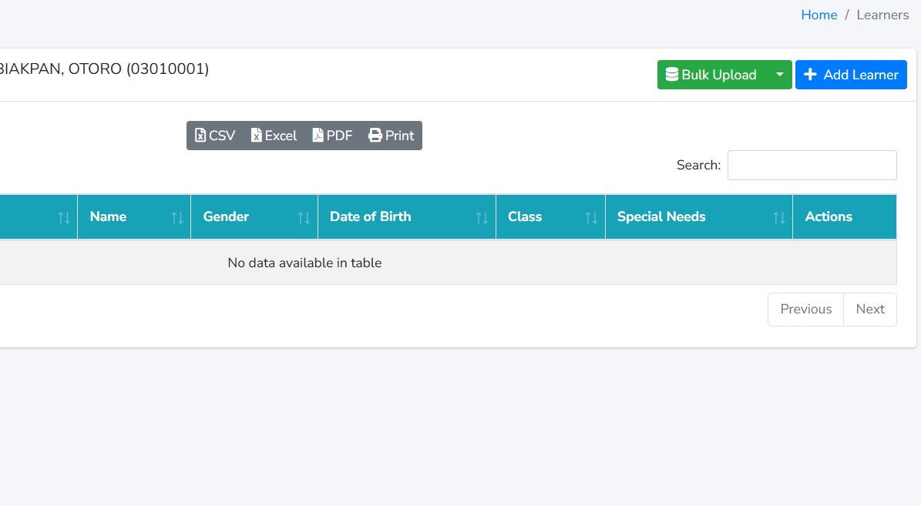
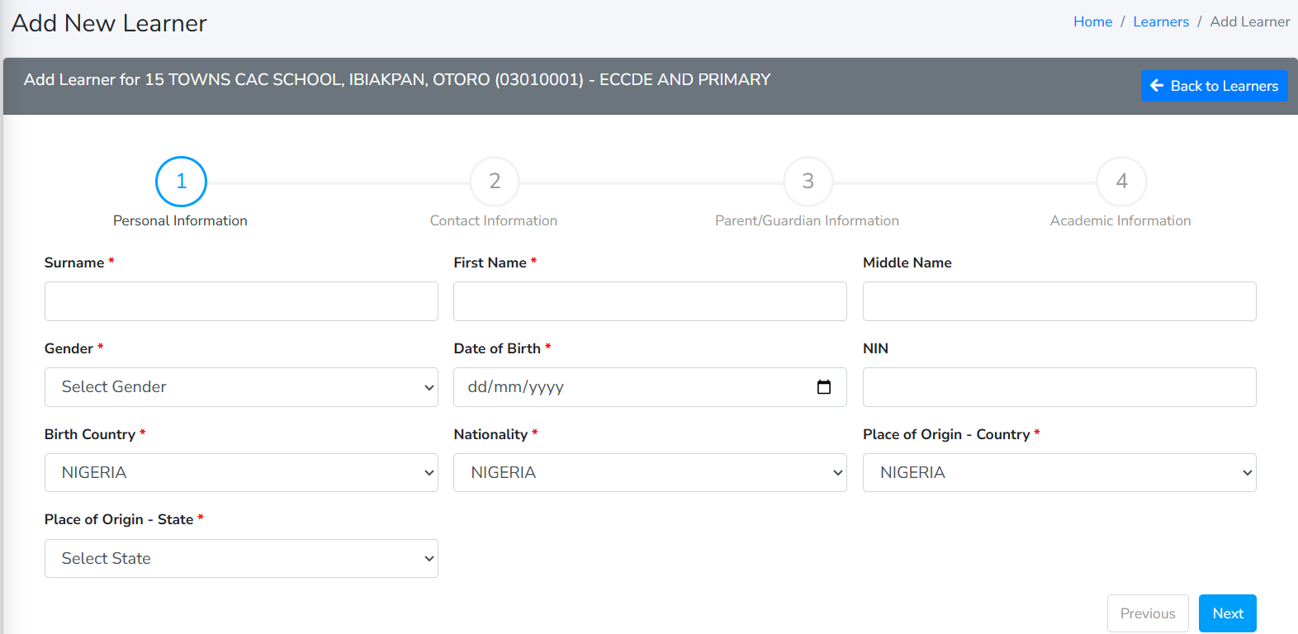
To Individually Add a Learner
Click on ‘Learners’
Click ‘Add Learner’
Then fill the form with the learner information
After adding the learner, the system automatically generates a Registration Number for the learner.

Slide 14
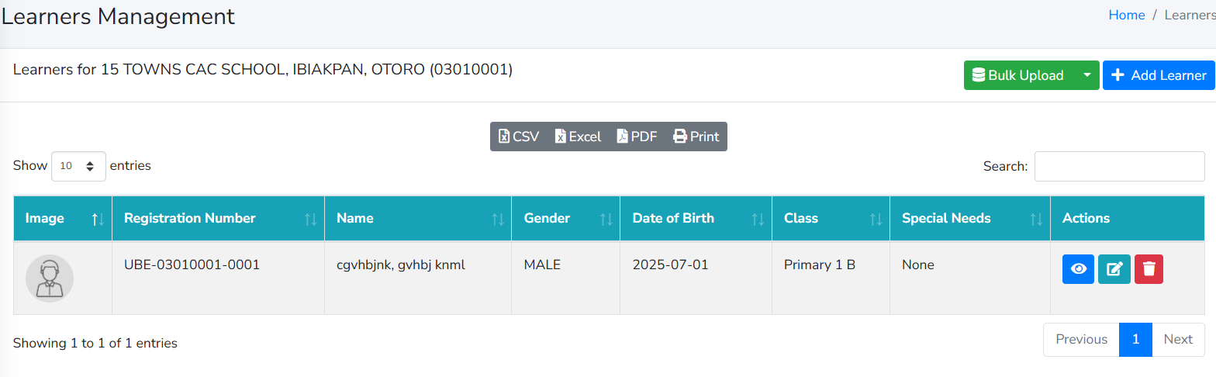
Updating a Learner’s Information
To view a learner’s information, click on the symbol under ‘Actions’ beside the learner’s name.
To edit a learner’s information, click on the symbol under ‘Actions’ beside the learner’s name.
To delete a learner’s information, click on the symbol under ‘Actions’ beside the learner’s name.

Slide 15
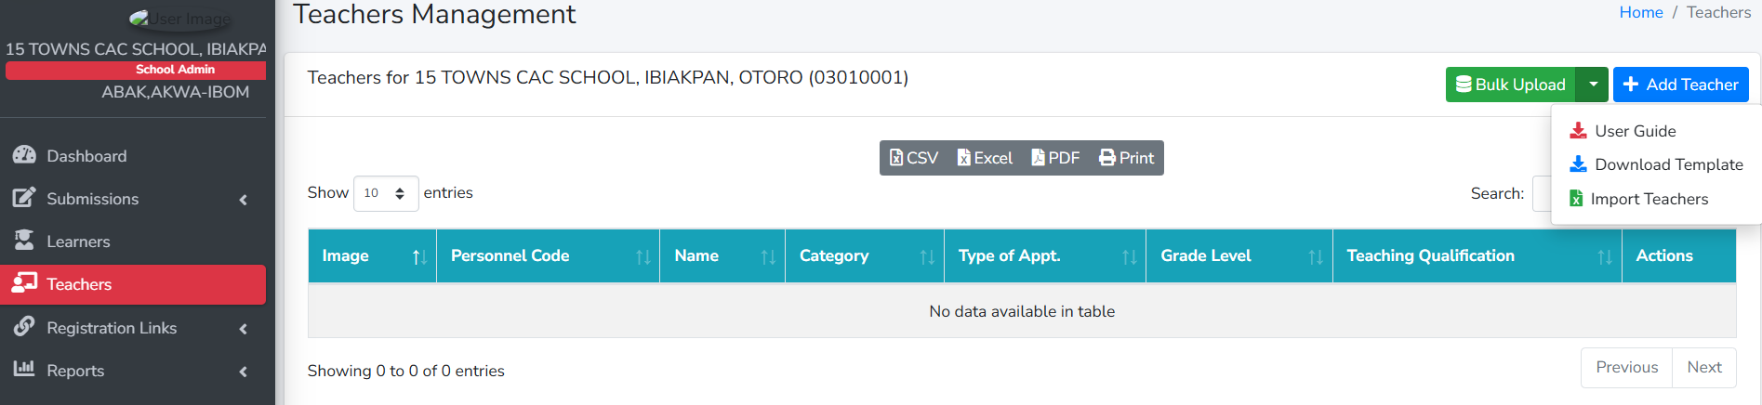
Teachers’ Management
The ‘Teachers’ module is like that of the Learners. You can also upload Teachers individually or in bulk using the User Guide as a guideline.

Slide 16
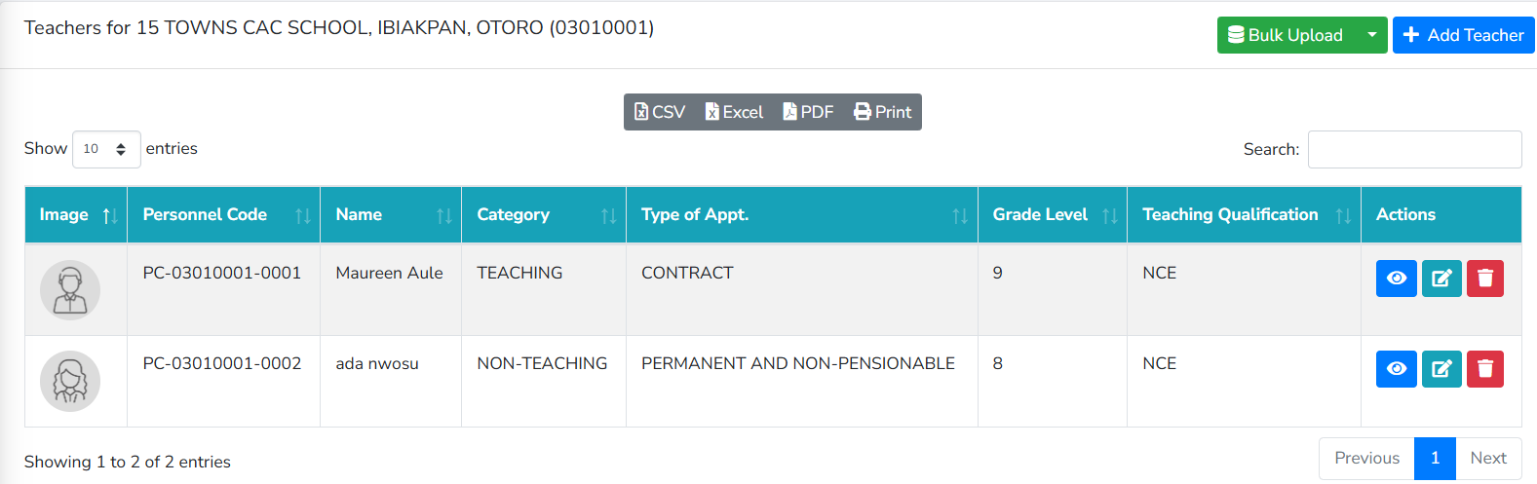
Updating a Teacher’s Information
To view a Teacher’s information, click on the symbol under ‘Actions’ beside the Teacher’s name.
To edit a Teacher’s information, click on the symbol under ‘Actions’ beside the Teacher’s name.
To delete a Teacher’s information, click on the symbol under ‘Actions’ beside the Teacher’s name.

Slide 17
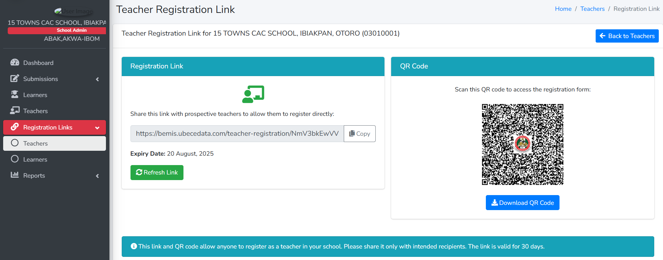
Adding Teachers’ Using the Registration Link
Click on ‘Teachers’ under the ‘Registration Links’. Then you can copy the link or scan the QR Code to add teachers. Note, the link is unique to a school and is valid for 30 days.

Slide 18
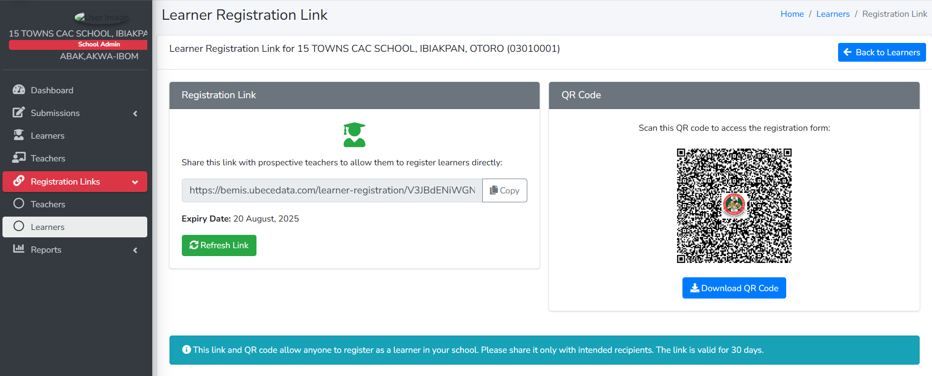
Adding Learners’ Using the Registration Link
Click on ‘Learners’ under the ‘Registration Links’. Then you can copy the link or scan the QR Code to add learners. Note, the link is unique to a school and is valid for 30 days.

Slide 19

PART TWO
Logging in through the Mobile Application

Slide 20
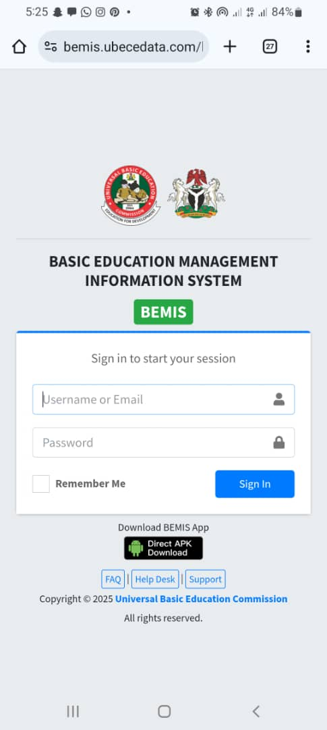
Installing the BEMIS App
Open any browser of your choice and go to the link bemis.ubecedata.com
Then click of Direct APK Download to download the app and install.

Slide 21
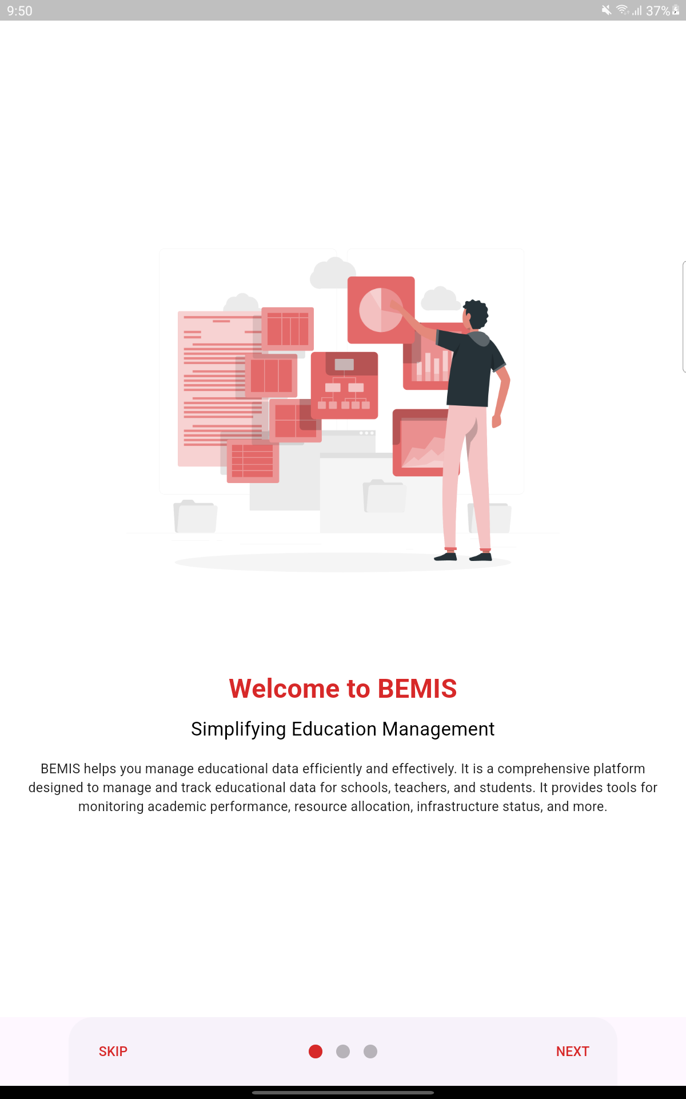
After downloading the app and installing, open the app and you will be directed to this landing page.

Slide 22
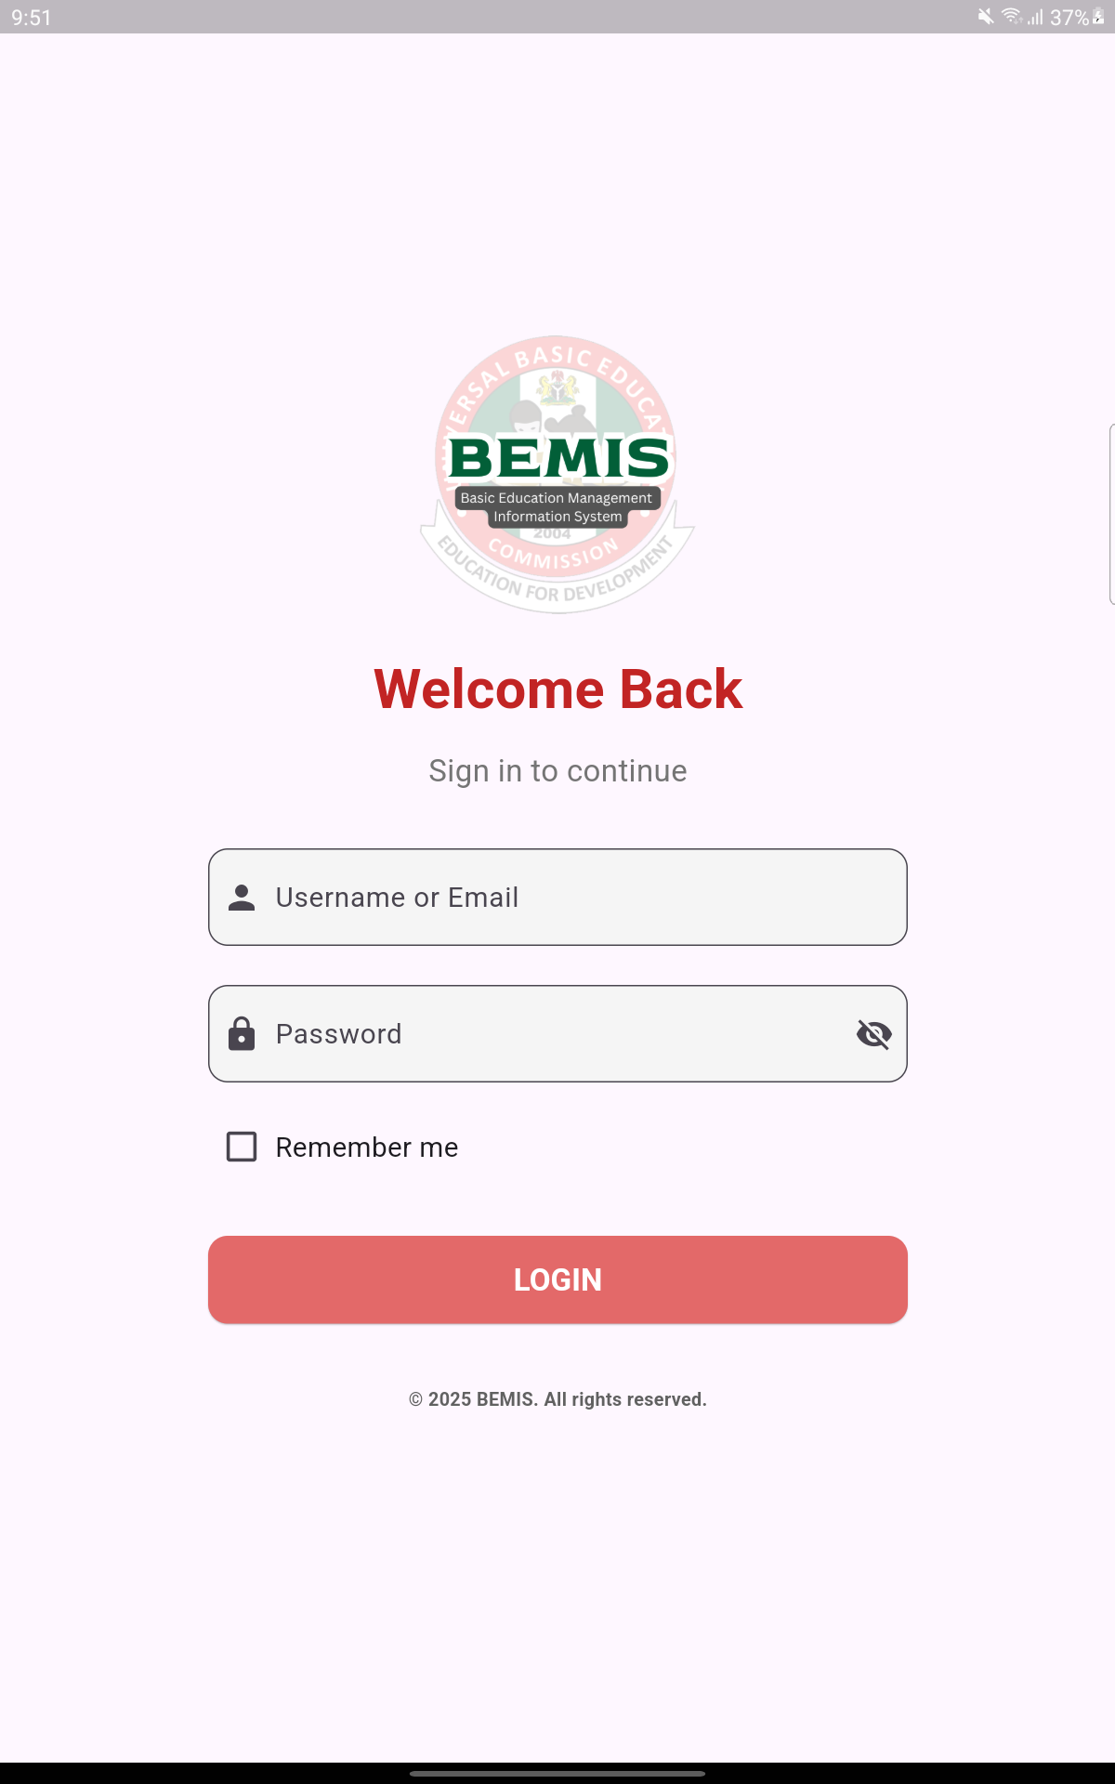
Login to the app using the school’s code and password provided

Slide 23
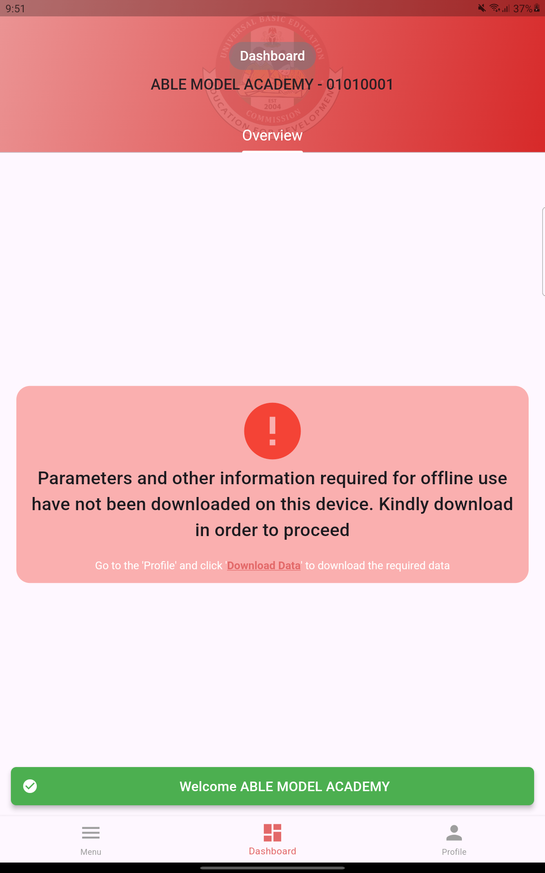
After logging in, you will be taken to the school’s dashboard. The School name and code will be displayed at the top.
There is a prompting in red asking you to download the parameters and other information in order to access the offline function of the app.

Slide 24
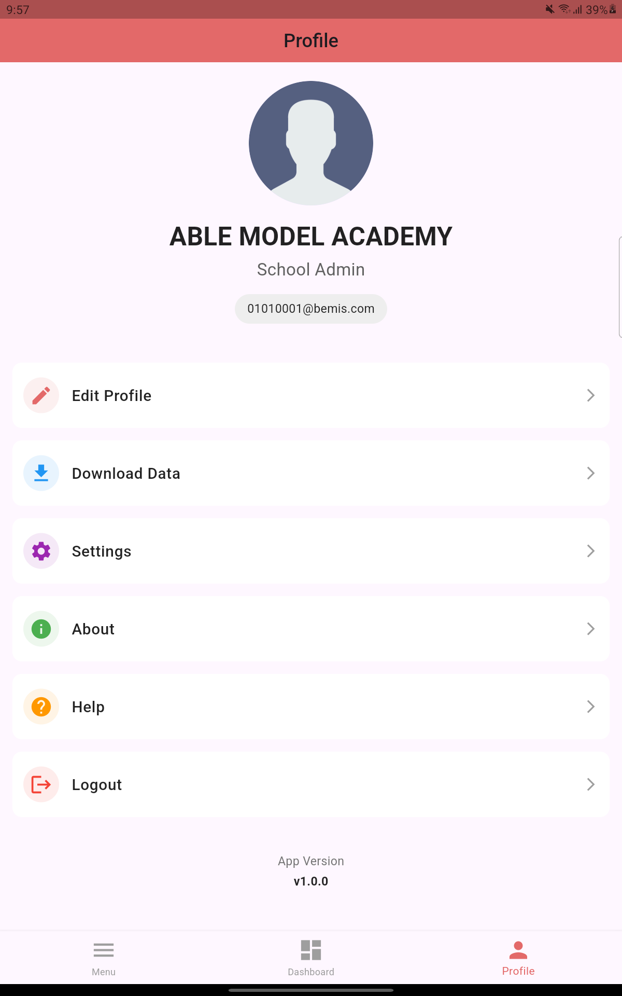
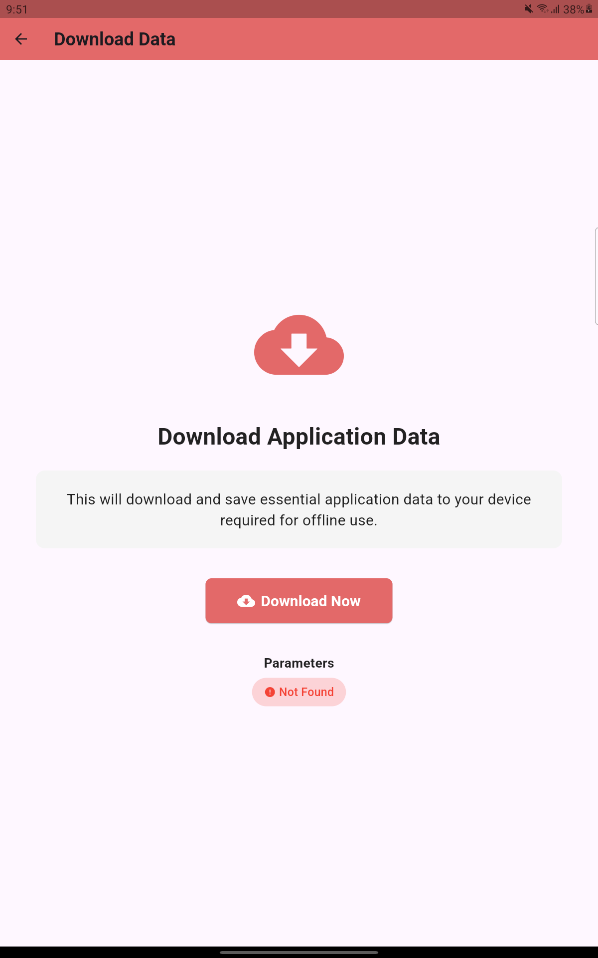
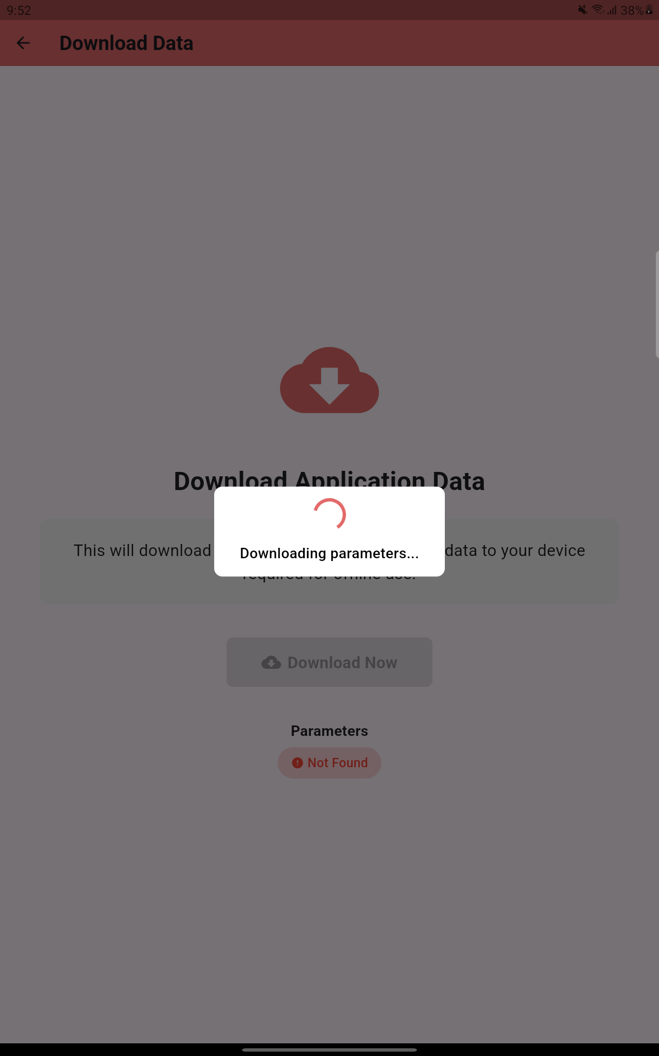
Downloading Parameters
Click on ‘Profile’ at the bottom right
Then click ‘Download Data’
Click on ‘Download Now’ to download the parameters
Parameters are downloading

Slide 25
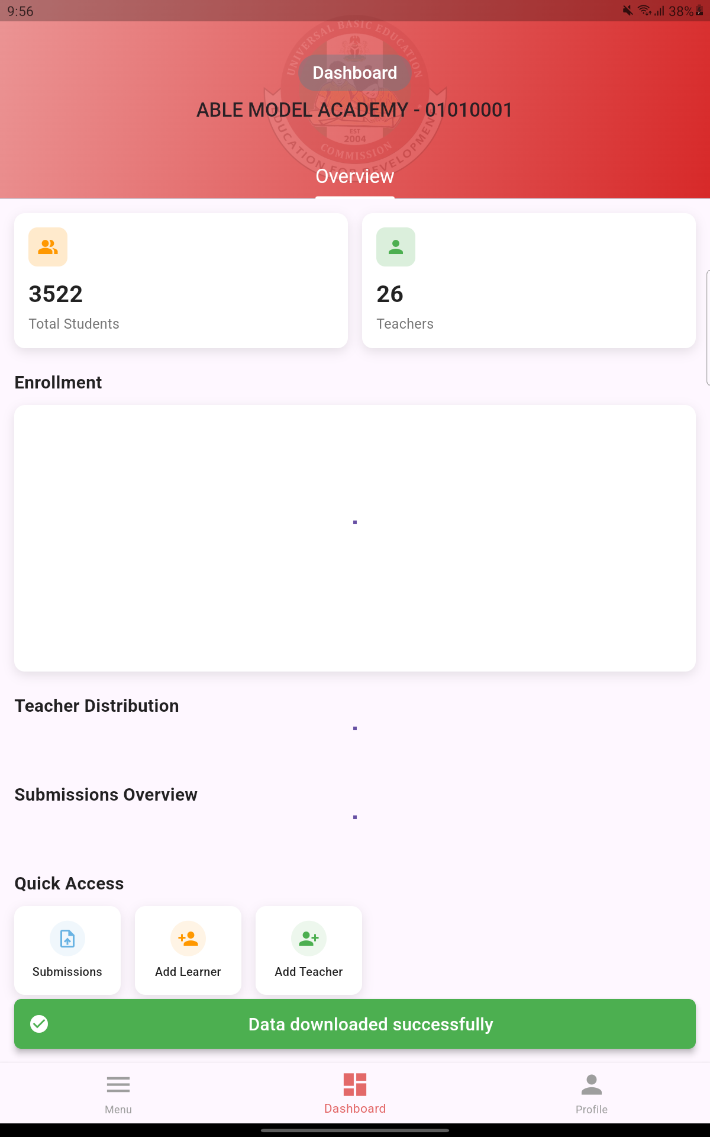
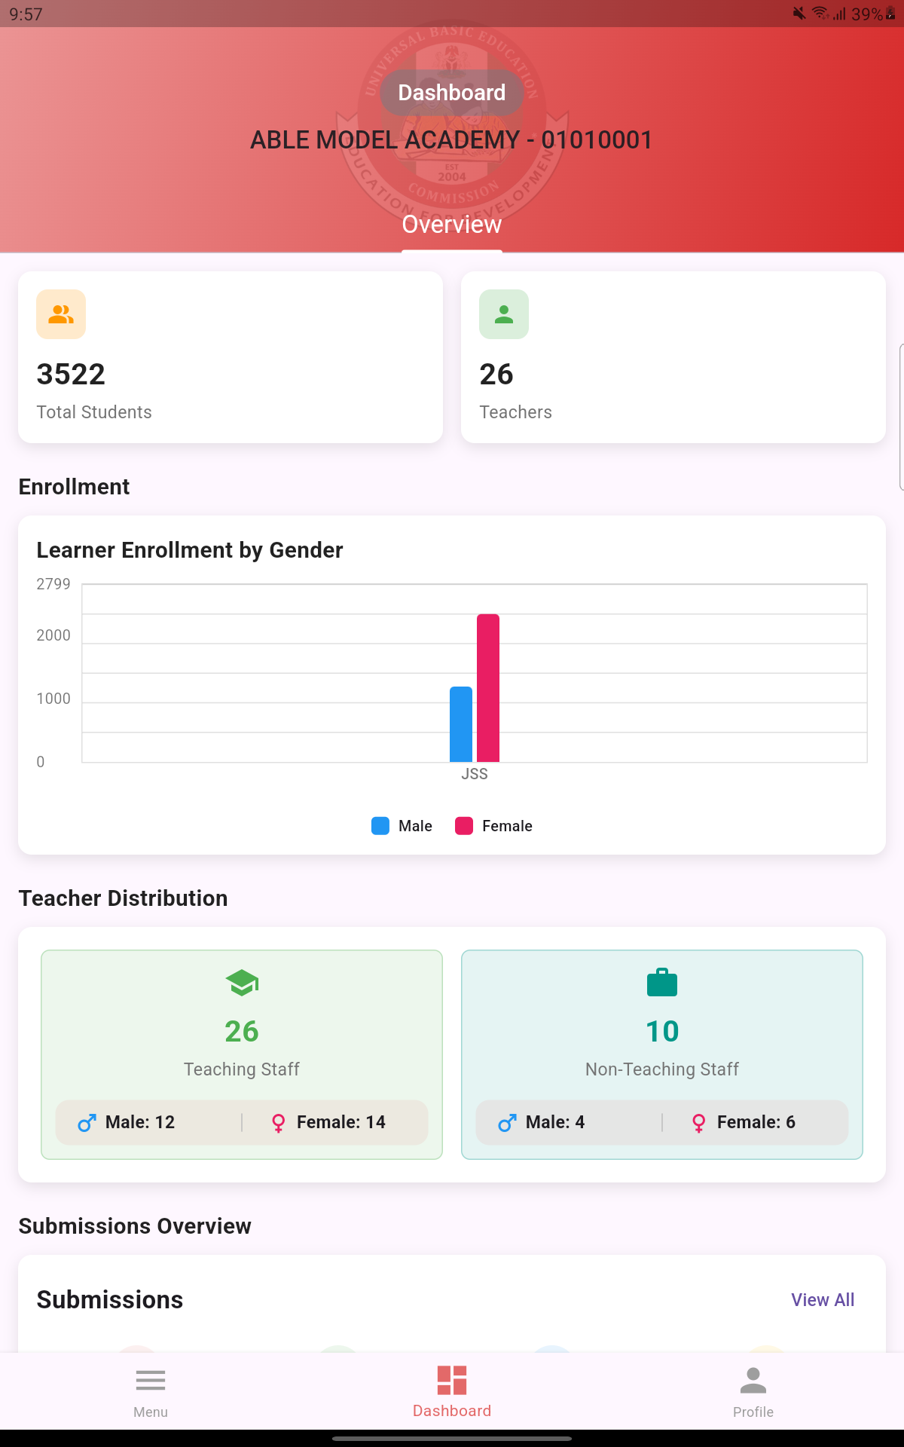
You will get the green prompt, after data has been downloaded successfully.
After a successful download, the data for the school will be populated if it exists.

Slide 26
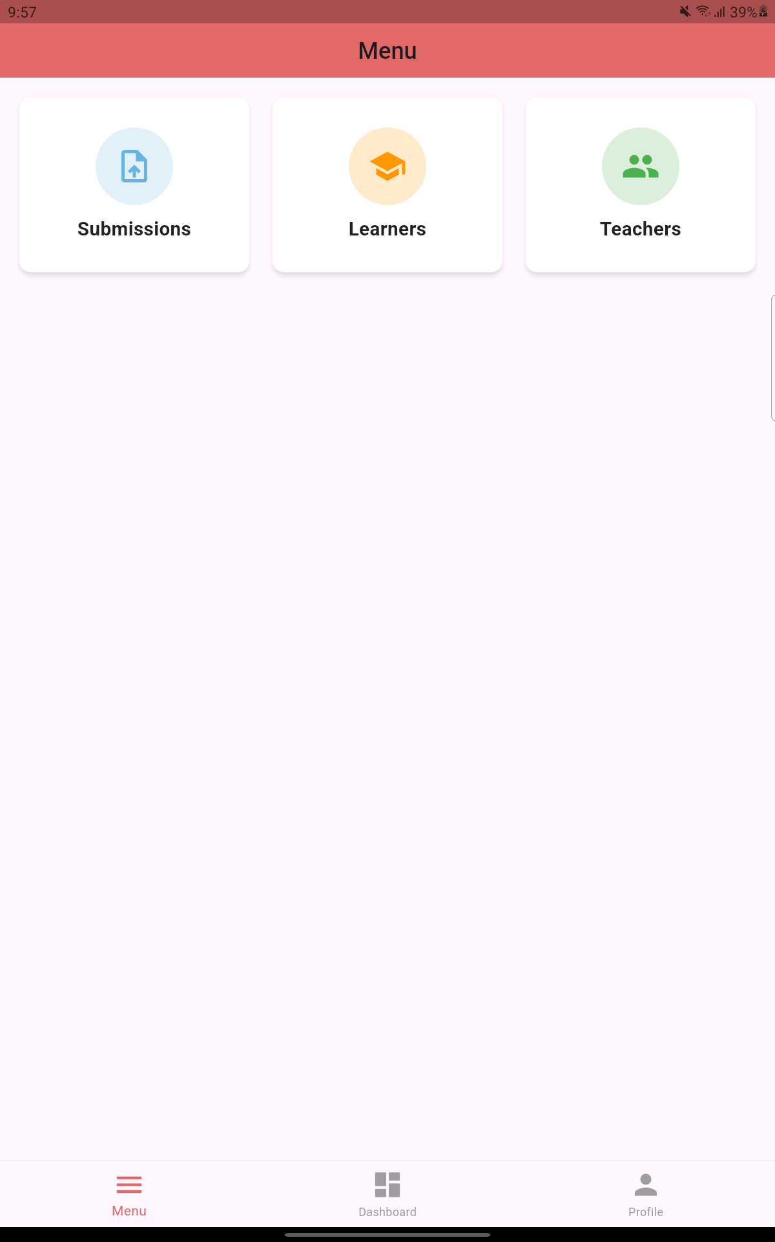
Components of BEMIS App
The BEMIS app has three (3) main modules:
Submission: For school data submission and update
Learners: For adding and updating learners' information
Teachers: For adding and updating teachers’ information

Slide 27
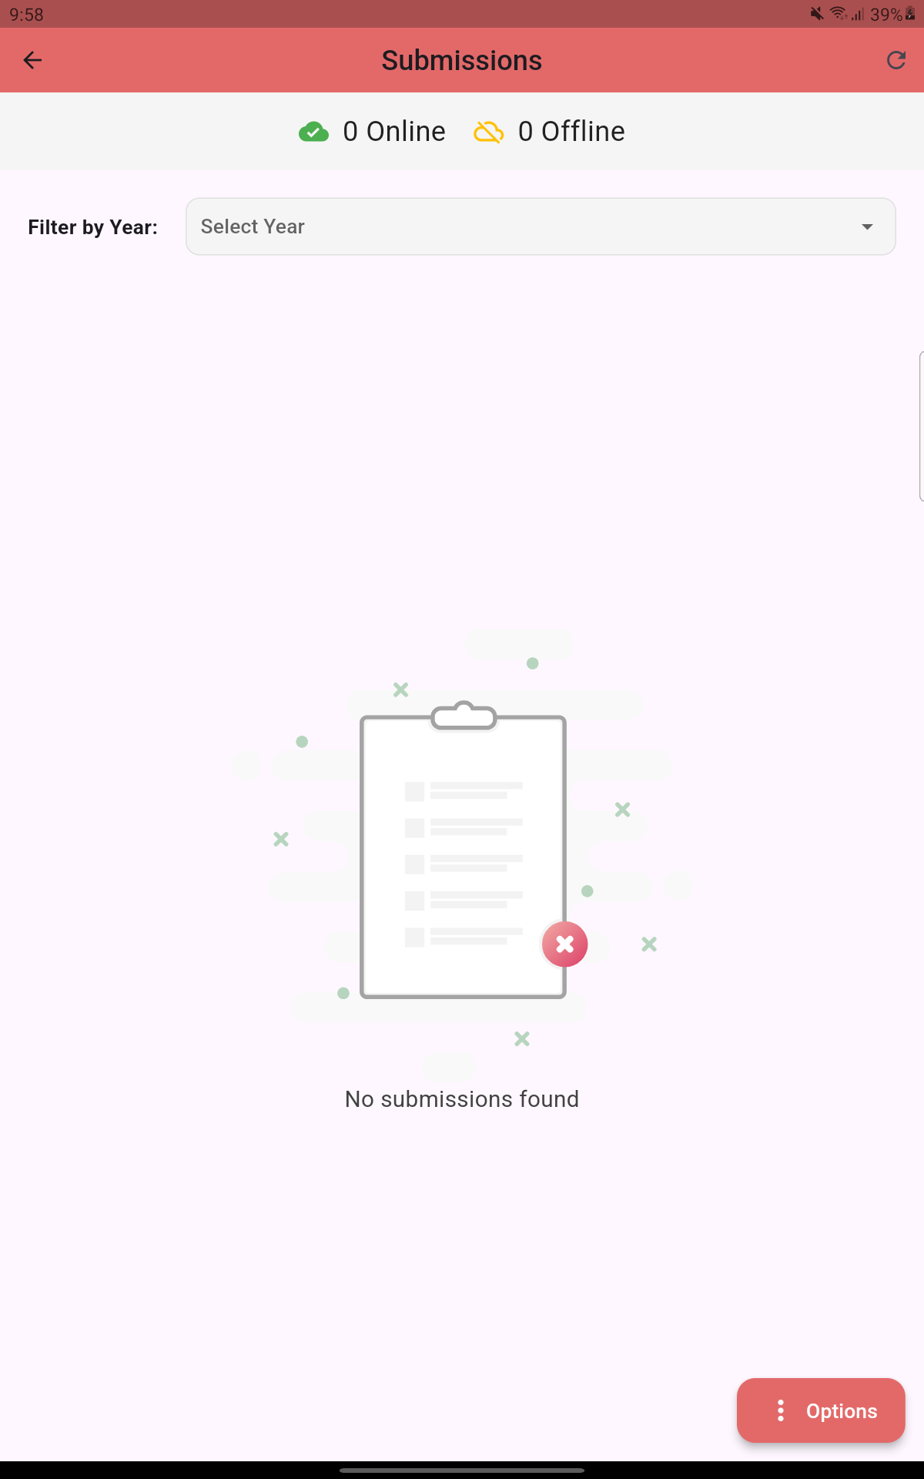
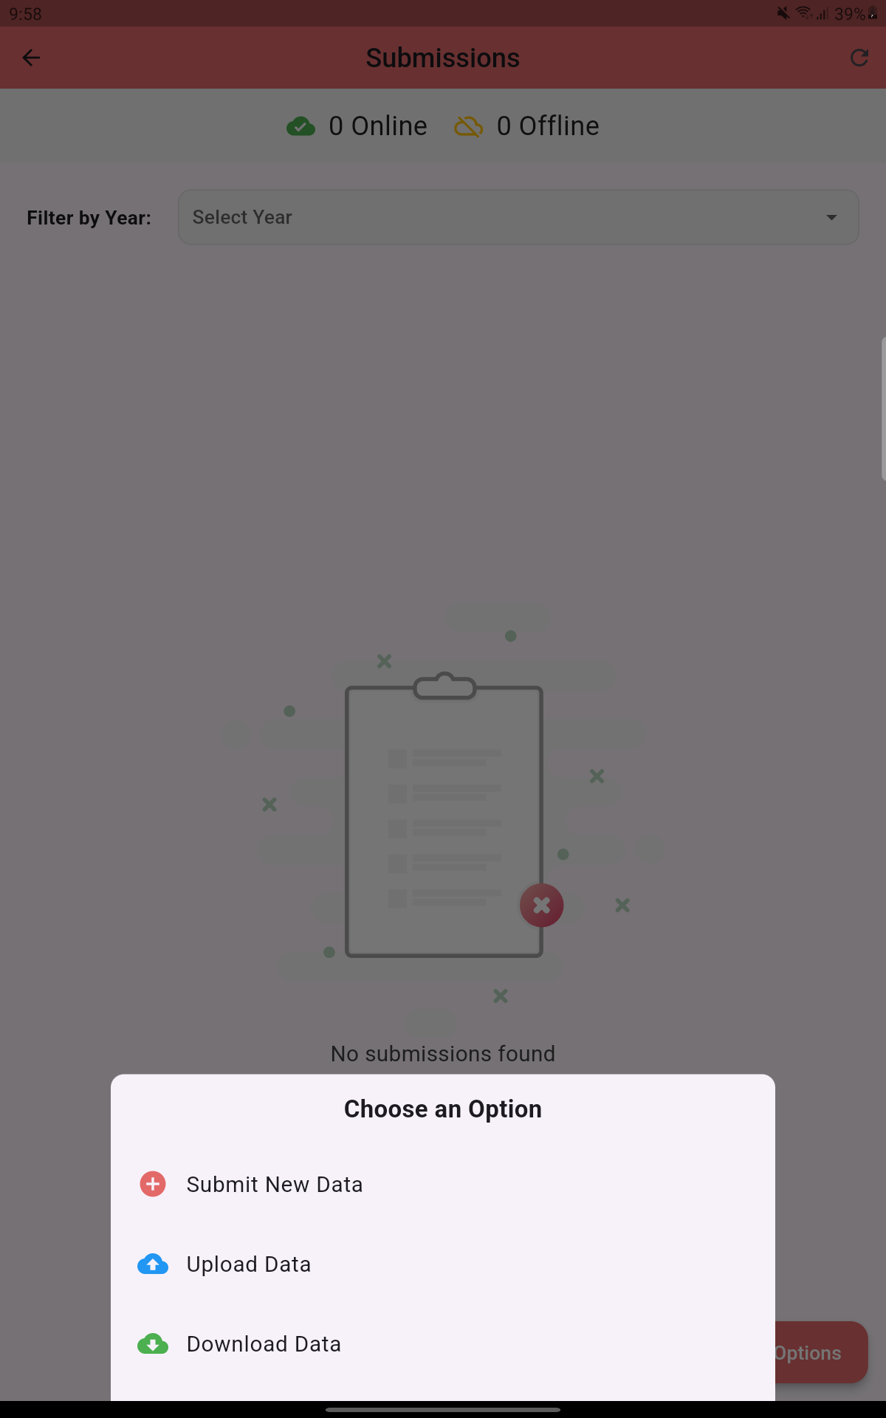
SUBMISSIONS MODULE
Click on the ‘Menu’ icon at the bottom left
Then click ‘Submissions’
Download the Data to load existing data
Click on the ‘Options’ icon at the bottom right
Click on the ‘Download Data’ from the drop-down

Slide 28
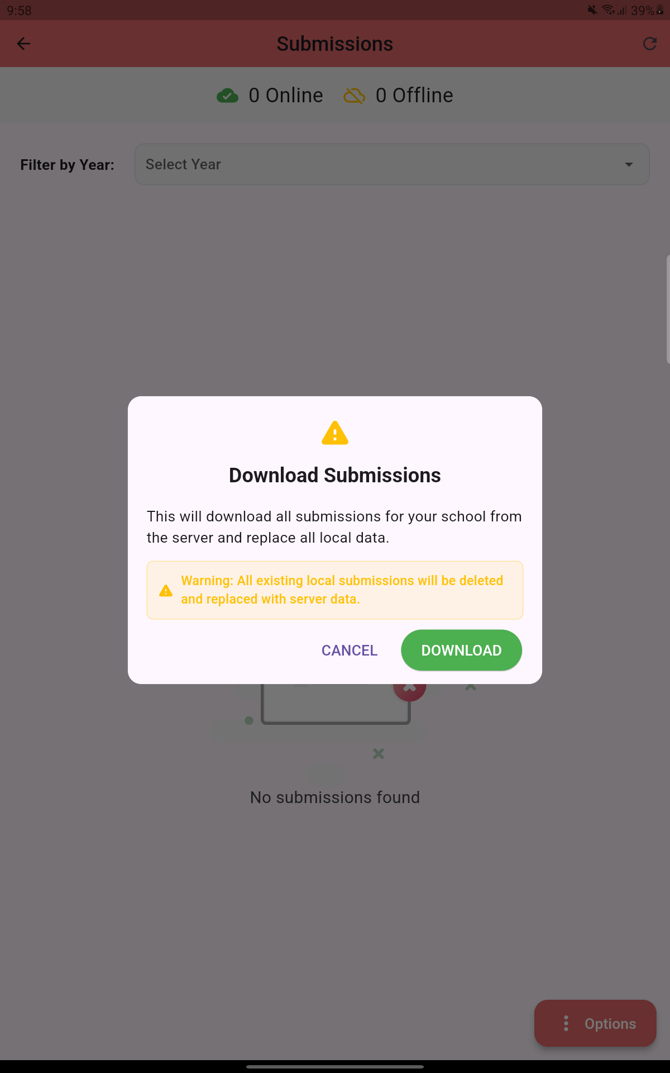
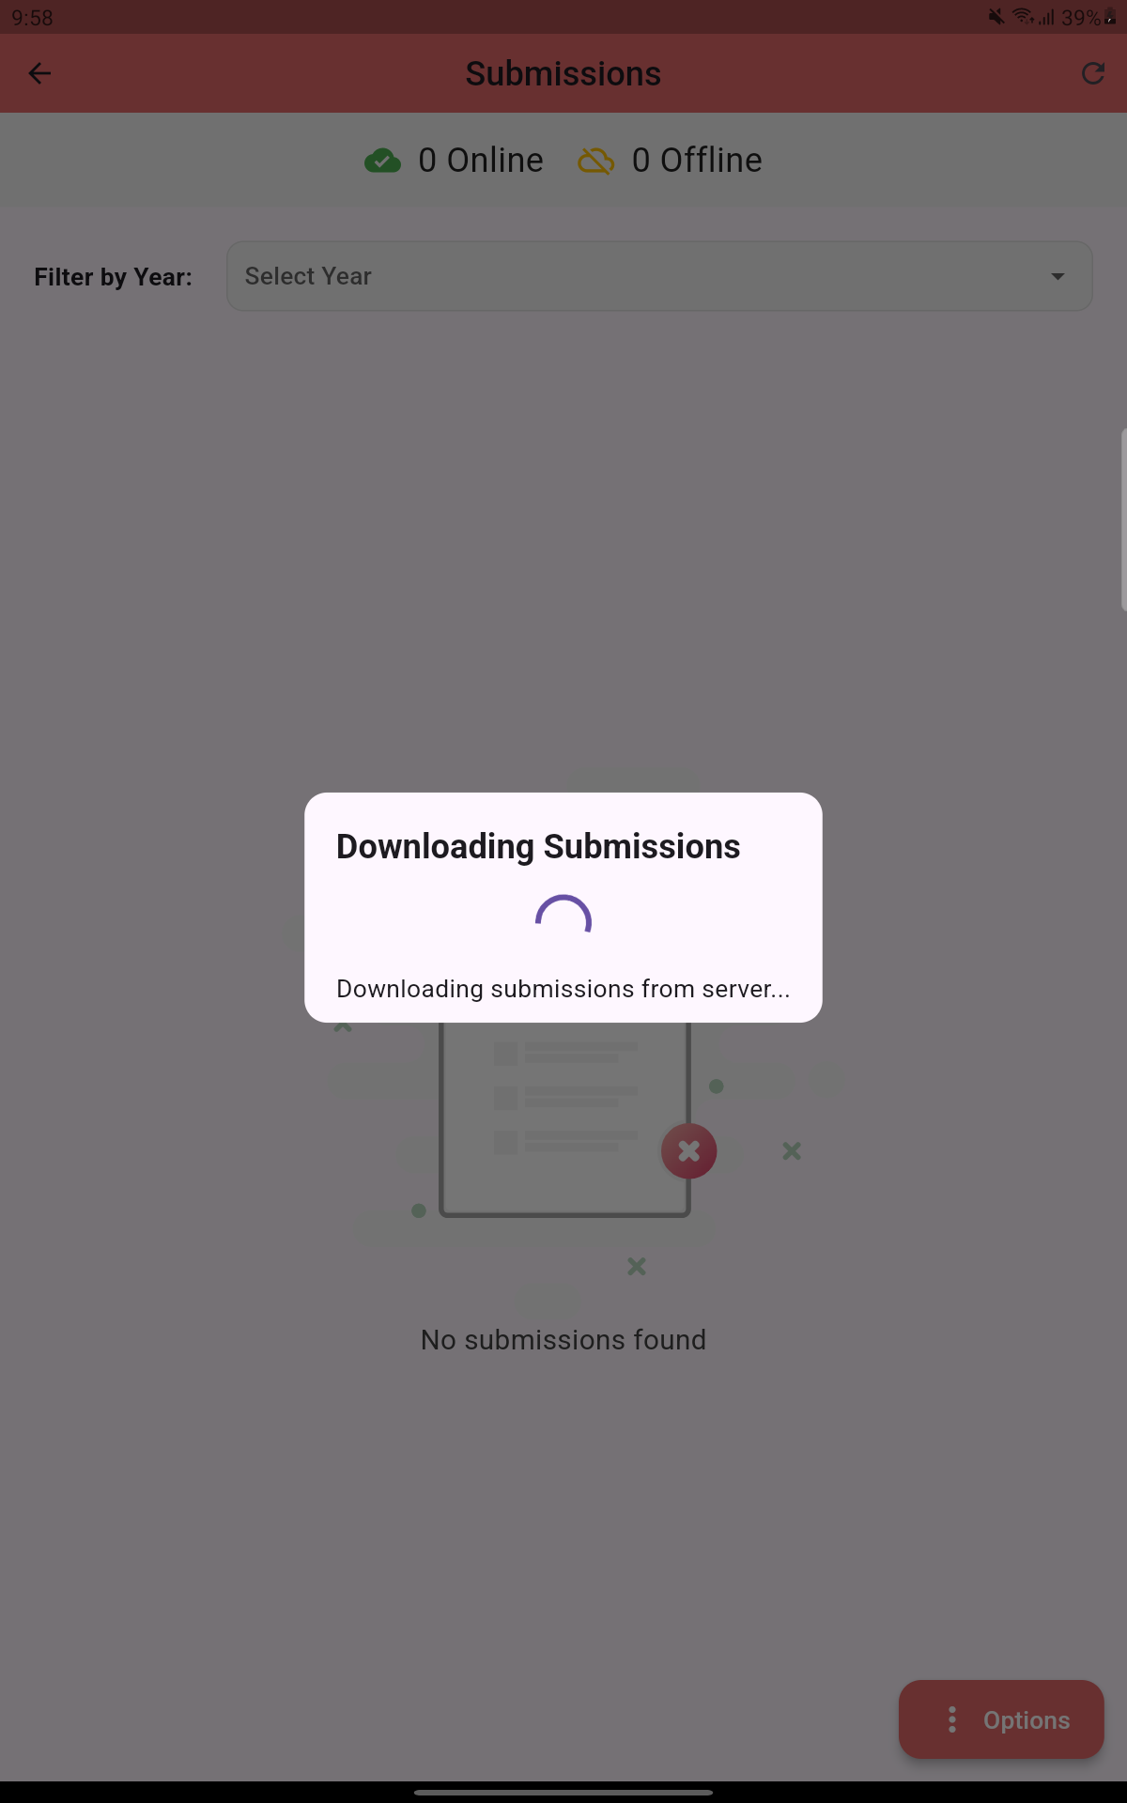
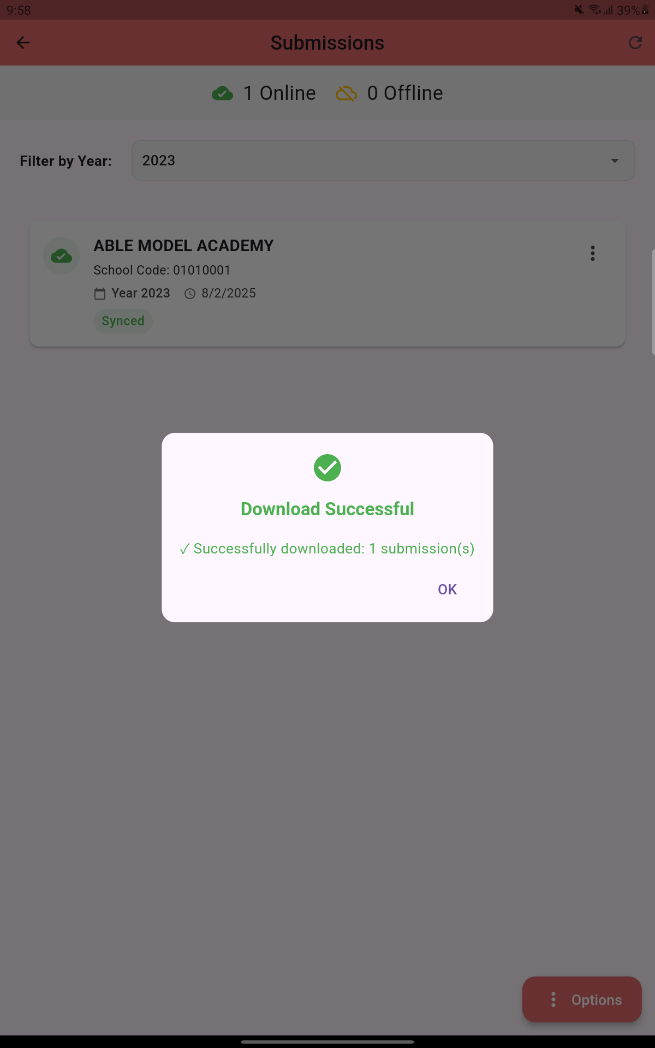
Already submitted ‘Submissions’ will be downloaded if any
Upon completion it will display ‘Download Successful’

Slide 29
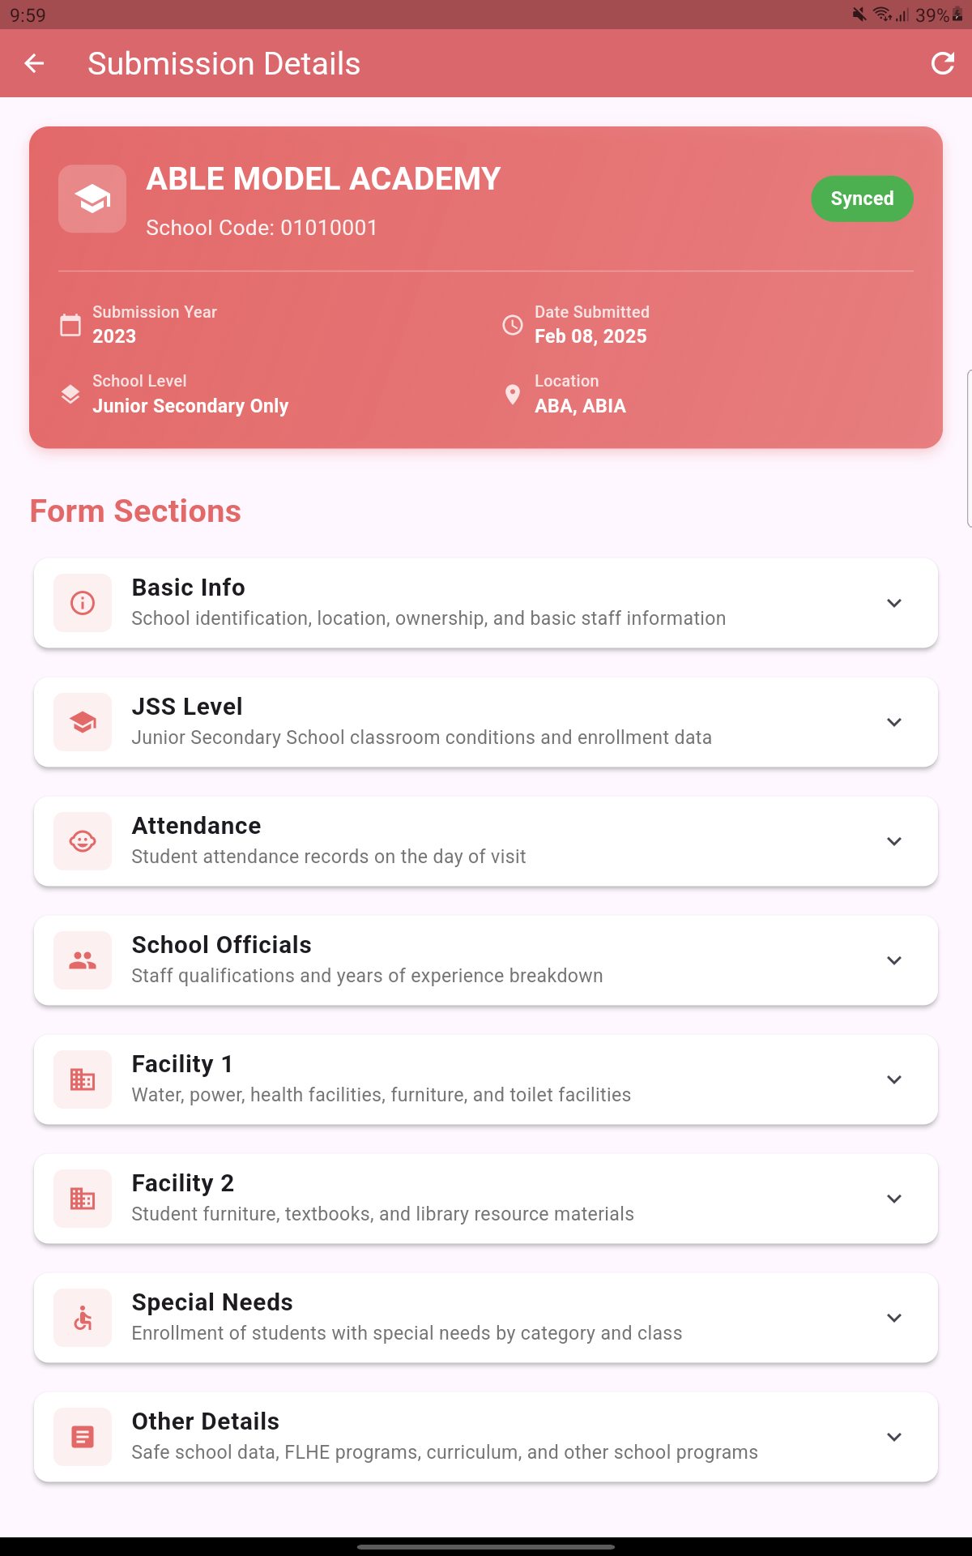
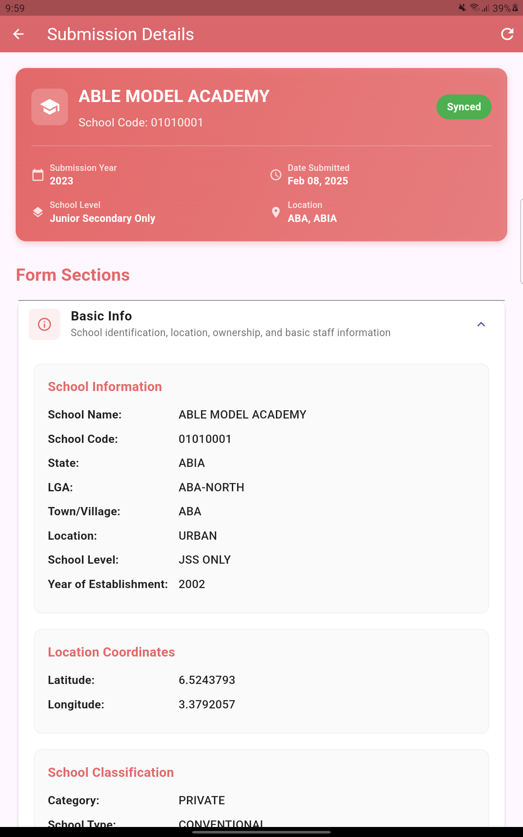
You can click on the school and the details of the school will be displayed section by section.
You can further click on any section for more information about the section.

Slide 30
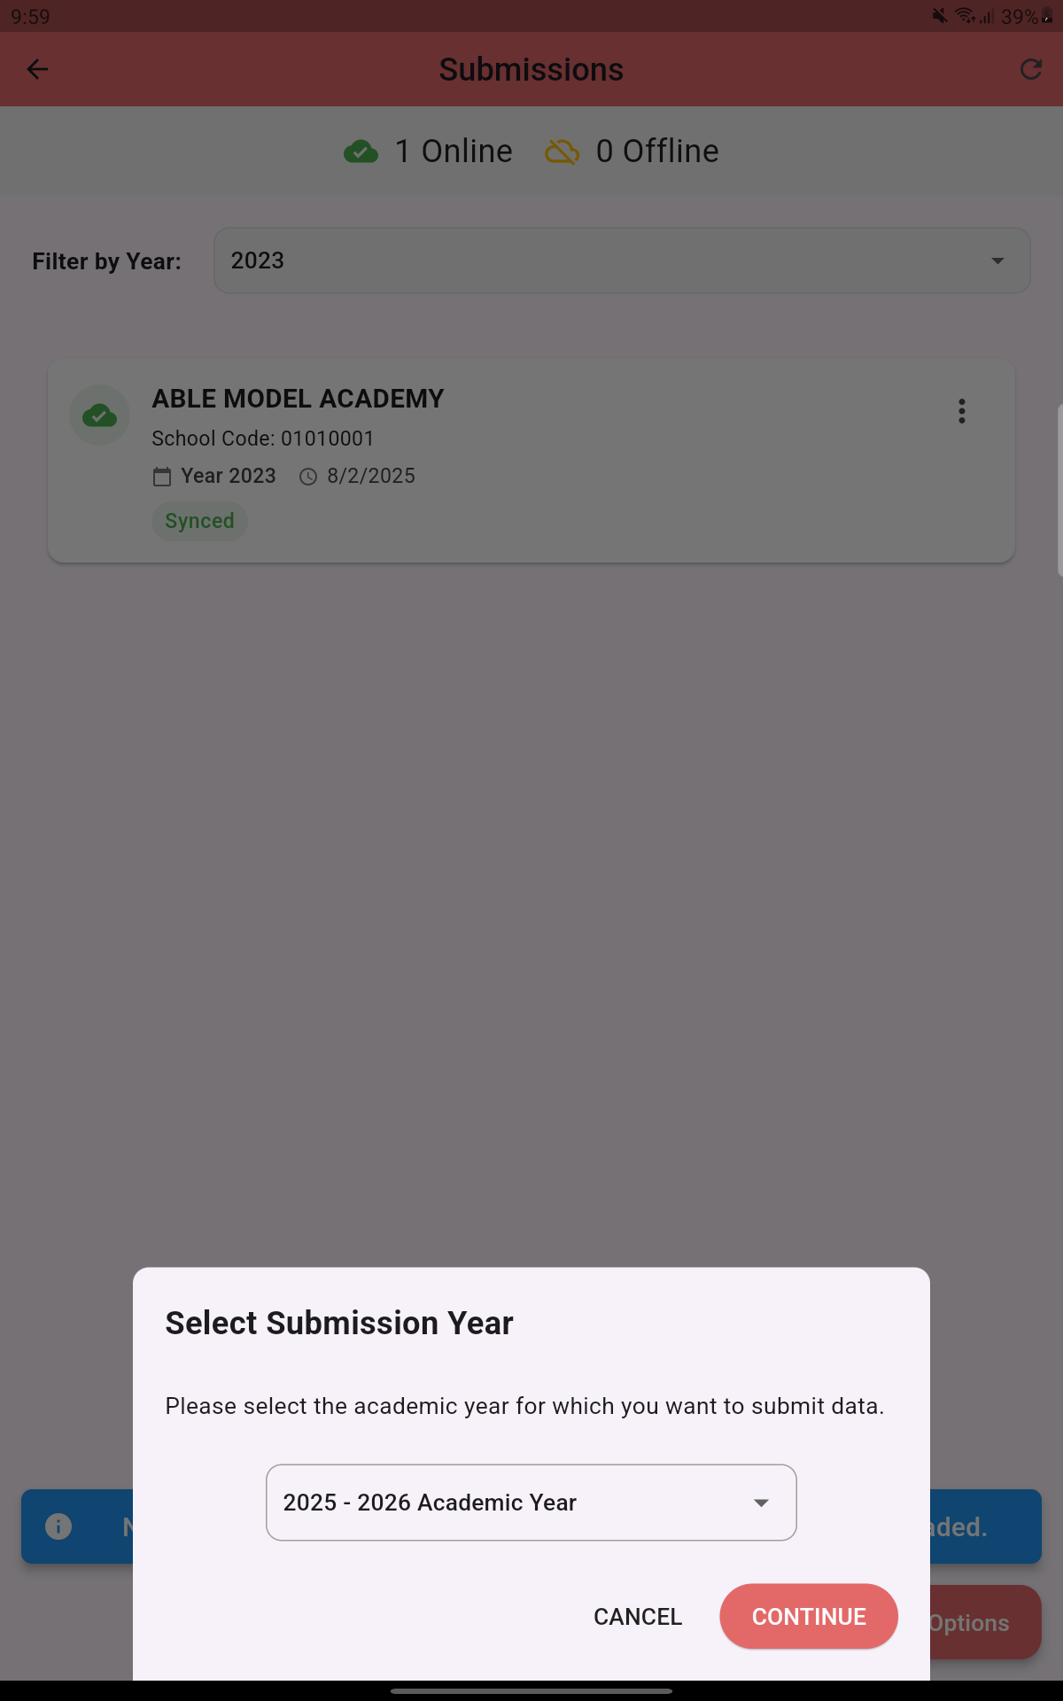
Adding a New Data/Record
To submit a new data
Click on the ‘Options’ icon at the bottom right
From the option menu displayed, select ‘Submit New Data’
Select the ‘Submission Year’ from the drop-down menu and then click ‘Continue’

Slide 31
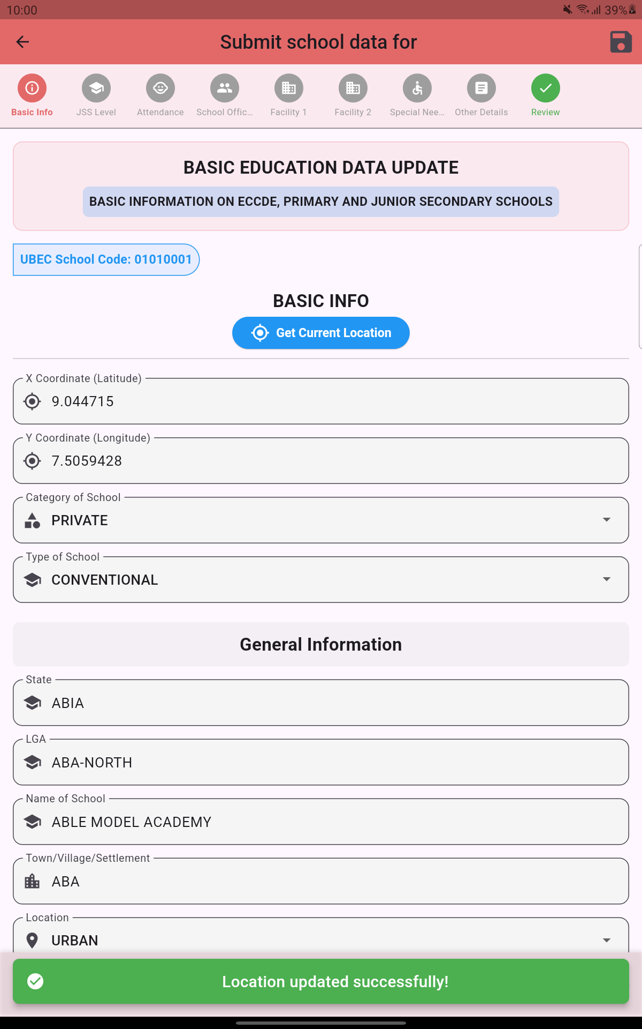
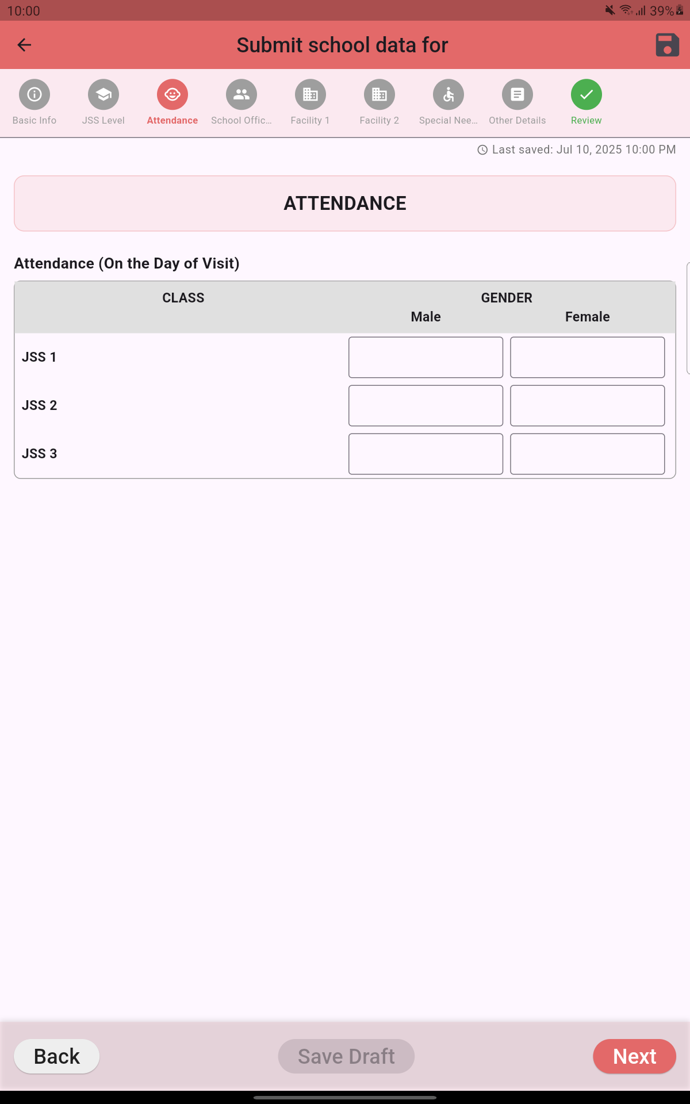
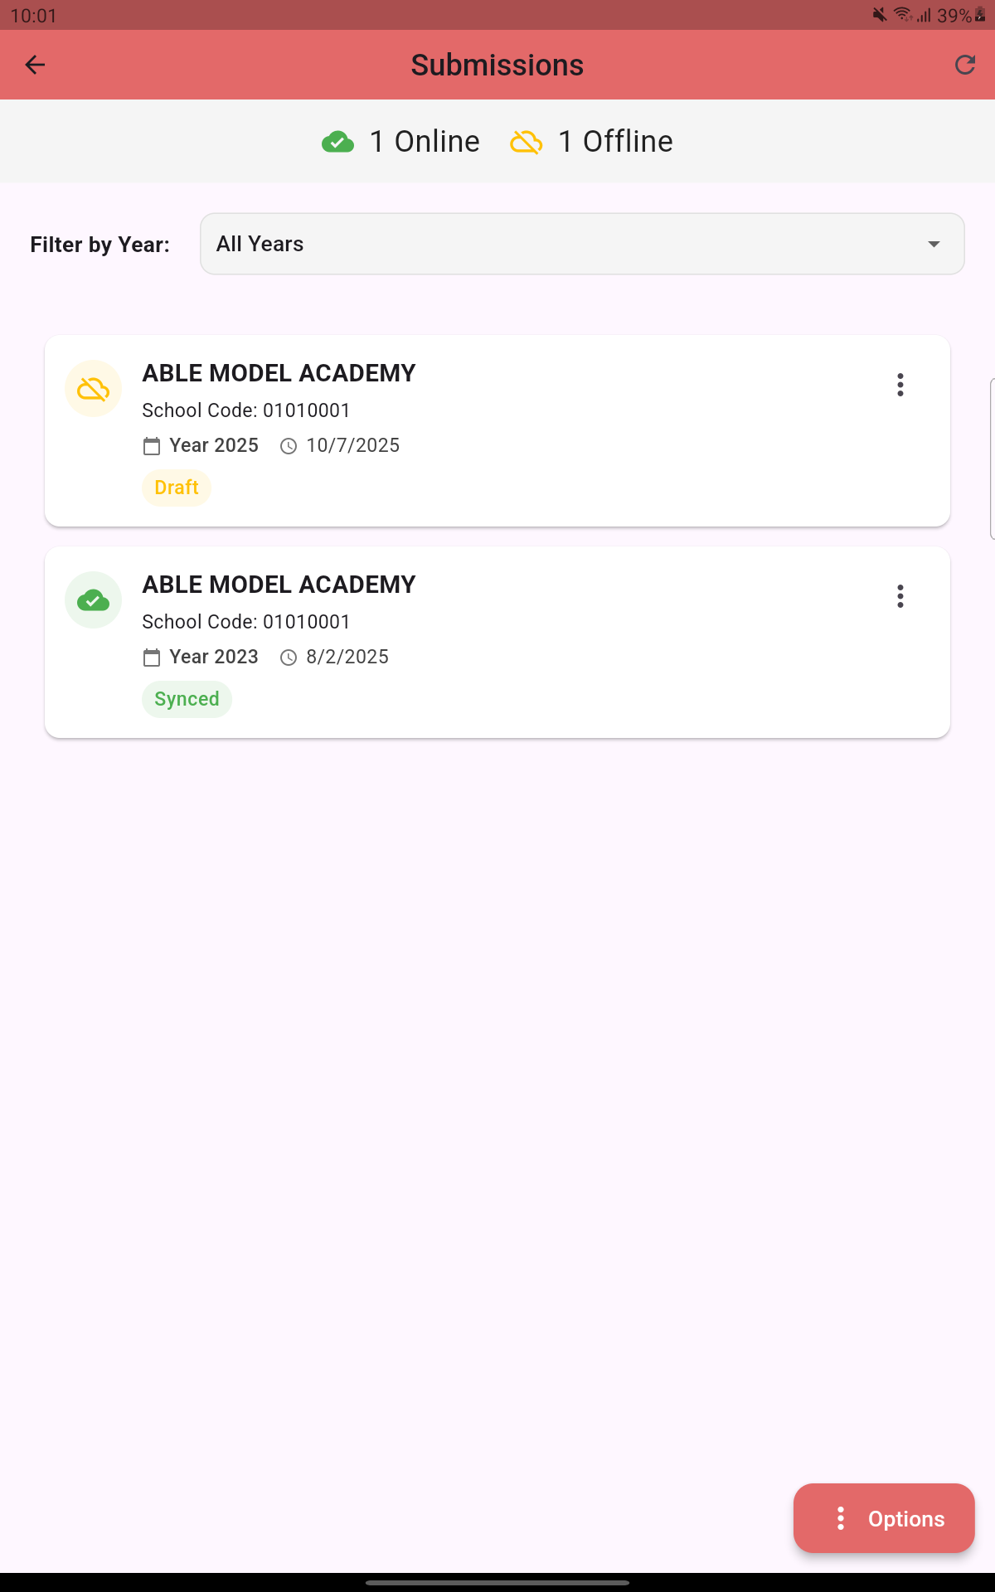
Proceed to fill the school information and click ‘Next’ to move to the next section.
Note: You can save form as draft and continue later by clicking ‘Save Draft’
Submissions not uploaded will be written as ‘Draft’ while those uploaded will be written ‘Synced’

Slide 32
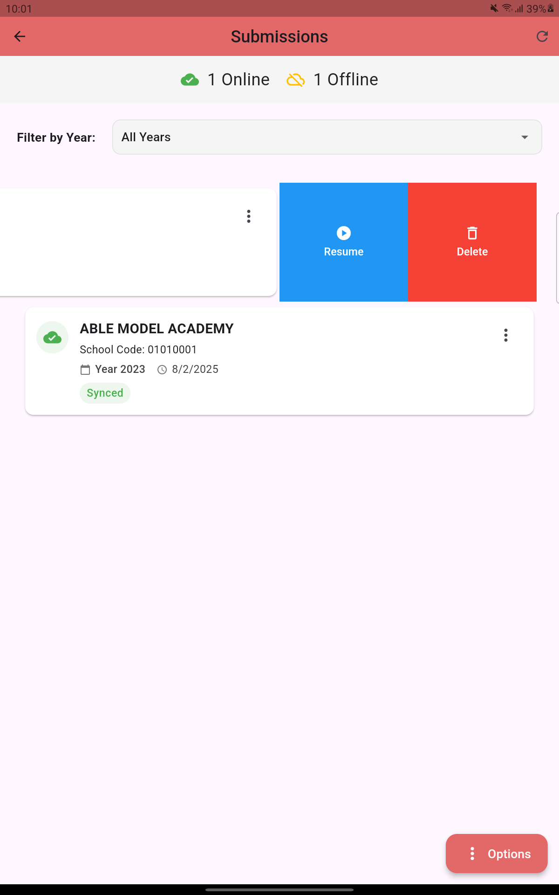
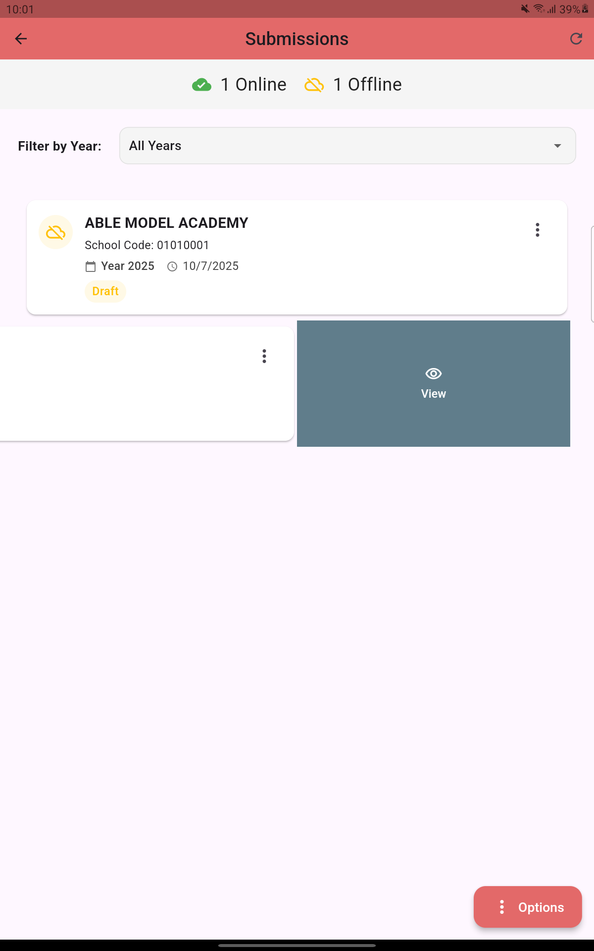
For a ‘Draft’ submission, you can swipe right to ‘Resume’ or ‘Delete’. Only Draft submissions can be edited.
For a ‘Synced’ submission, you can swipe right to view. Note: Synced or uploaded submissions can’t be edited.

Slide 33
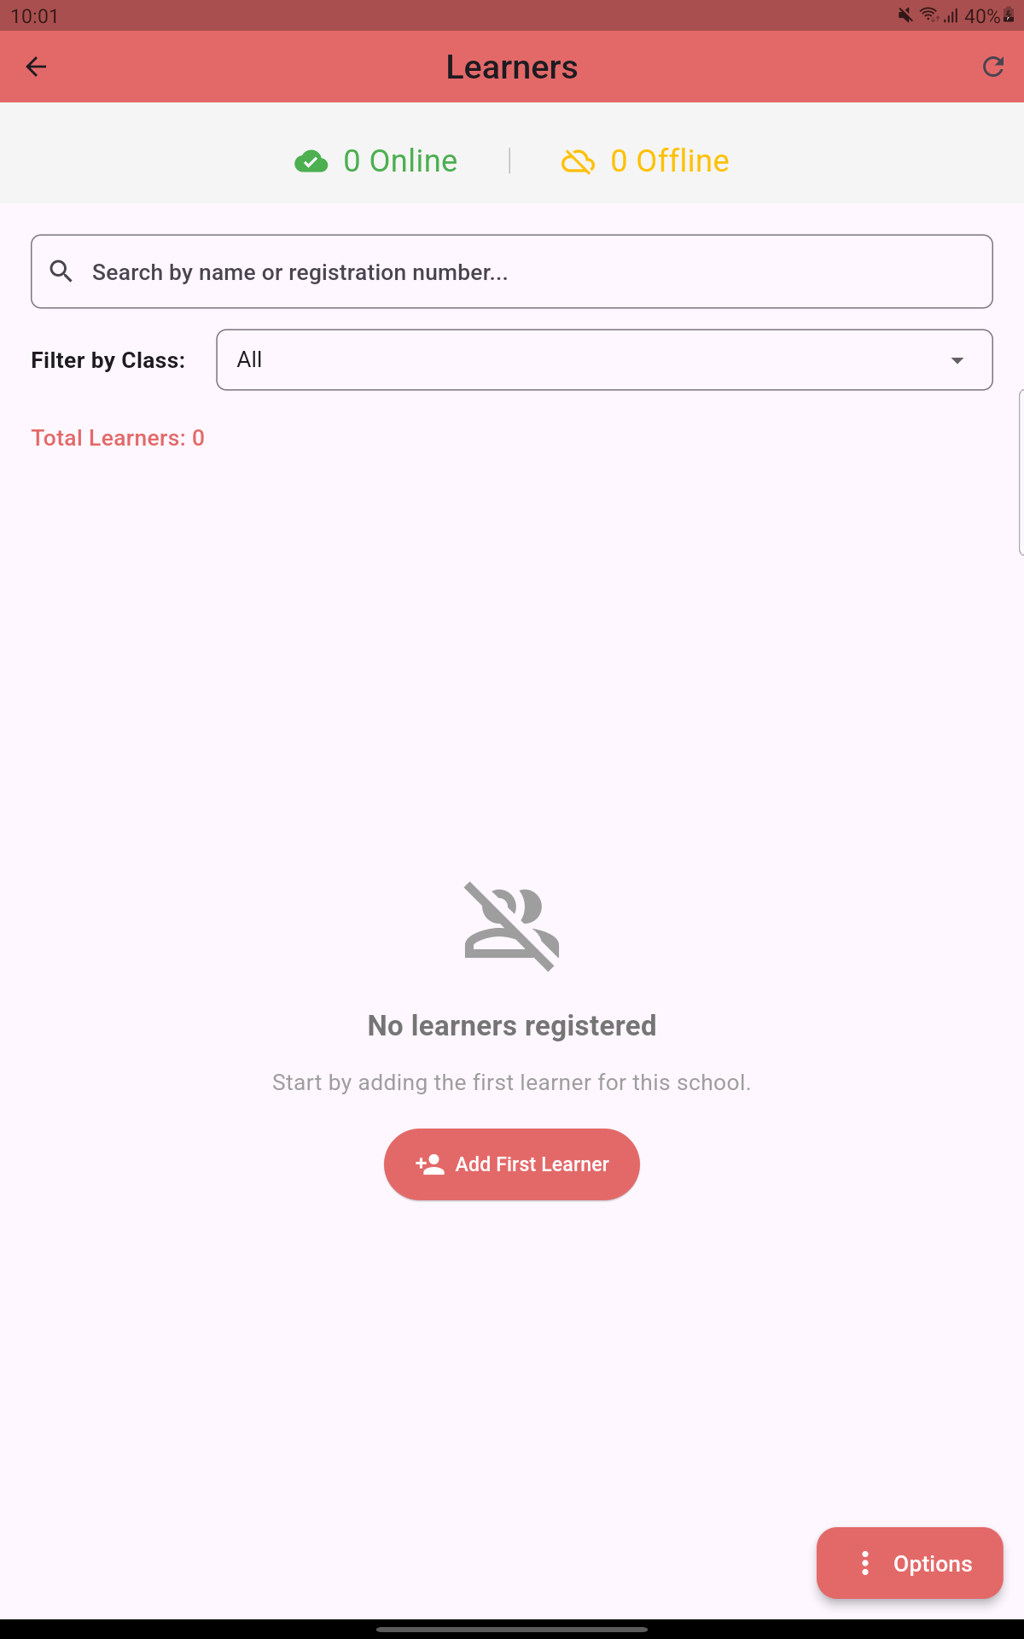
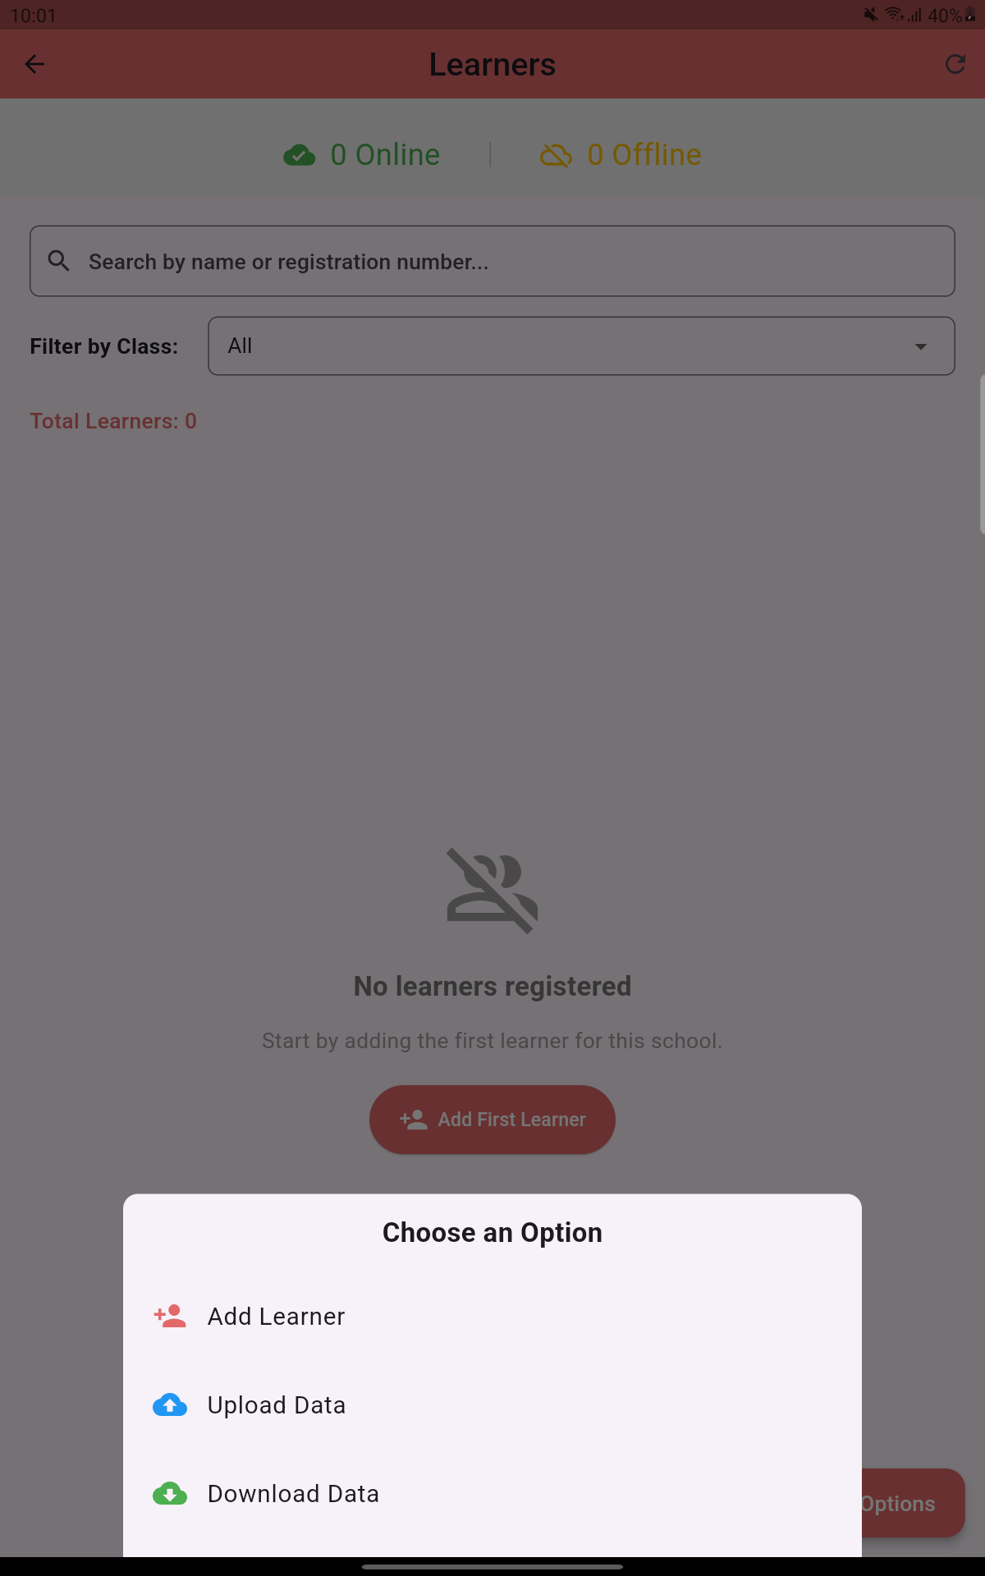
LEARNERS MODULE
To add or update Learners’ Information, click ‘Menu’ and then ‘Learners’ icon.
Click ‘Add First Learner’ icon to add a learner or ‘Options’ then ‘Add Learner’.
Click ‘Options’ to ‘Add Learner’, ‘Upload Data’ or ‘Download Data’.

Slide 34
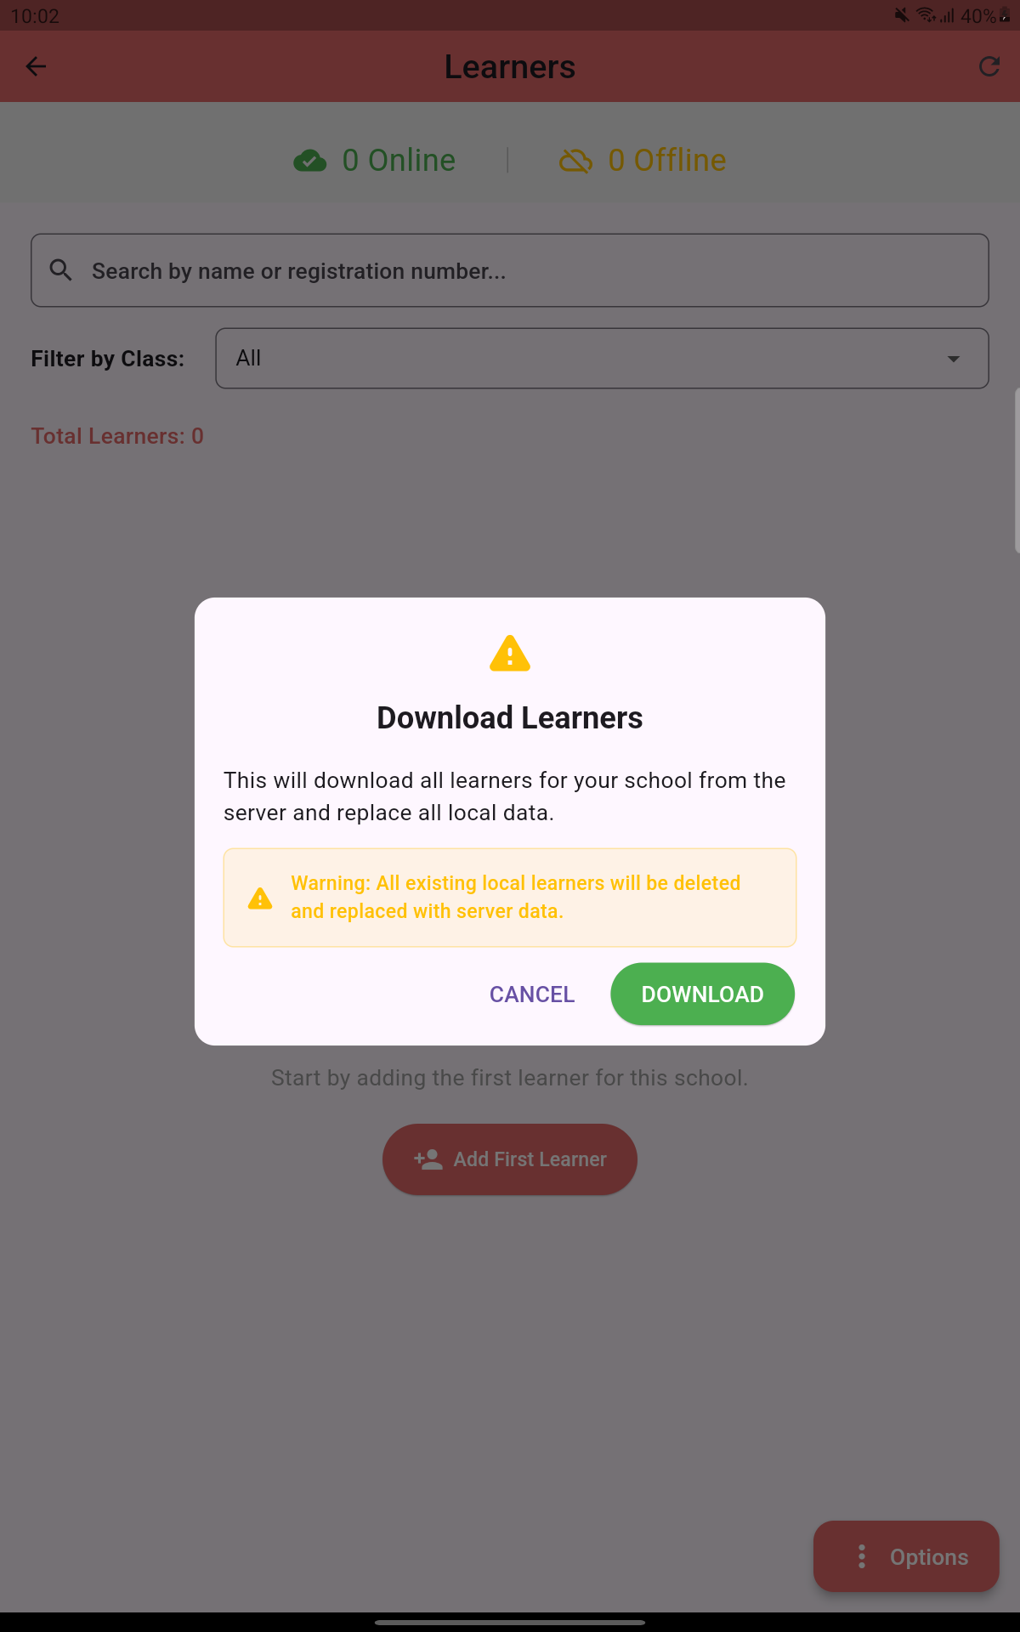
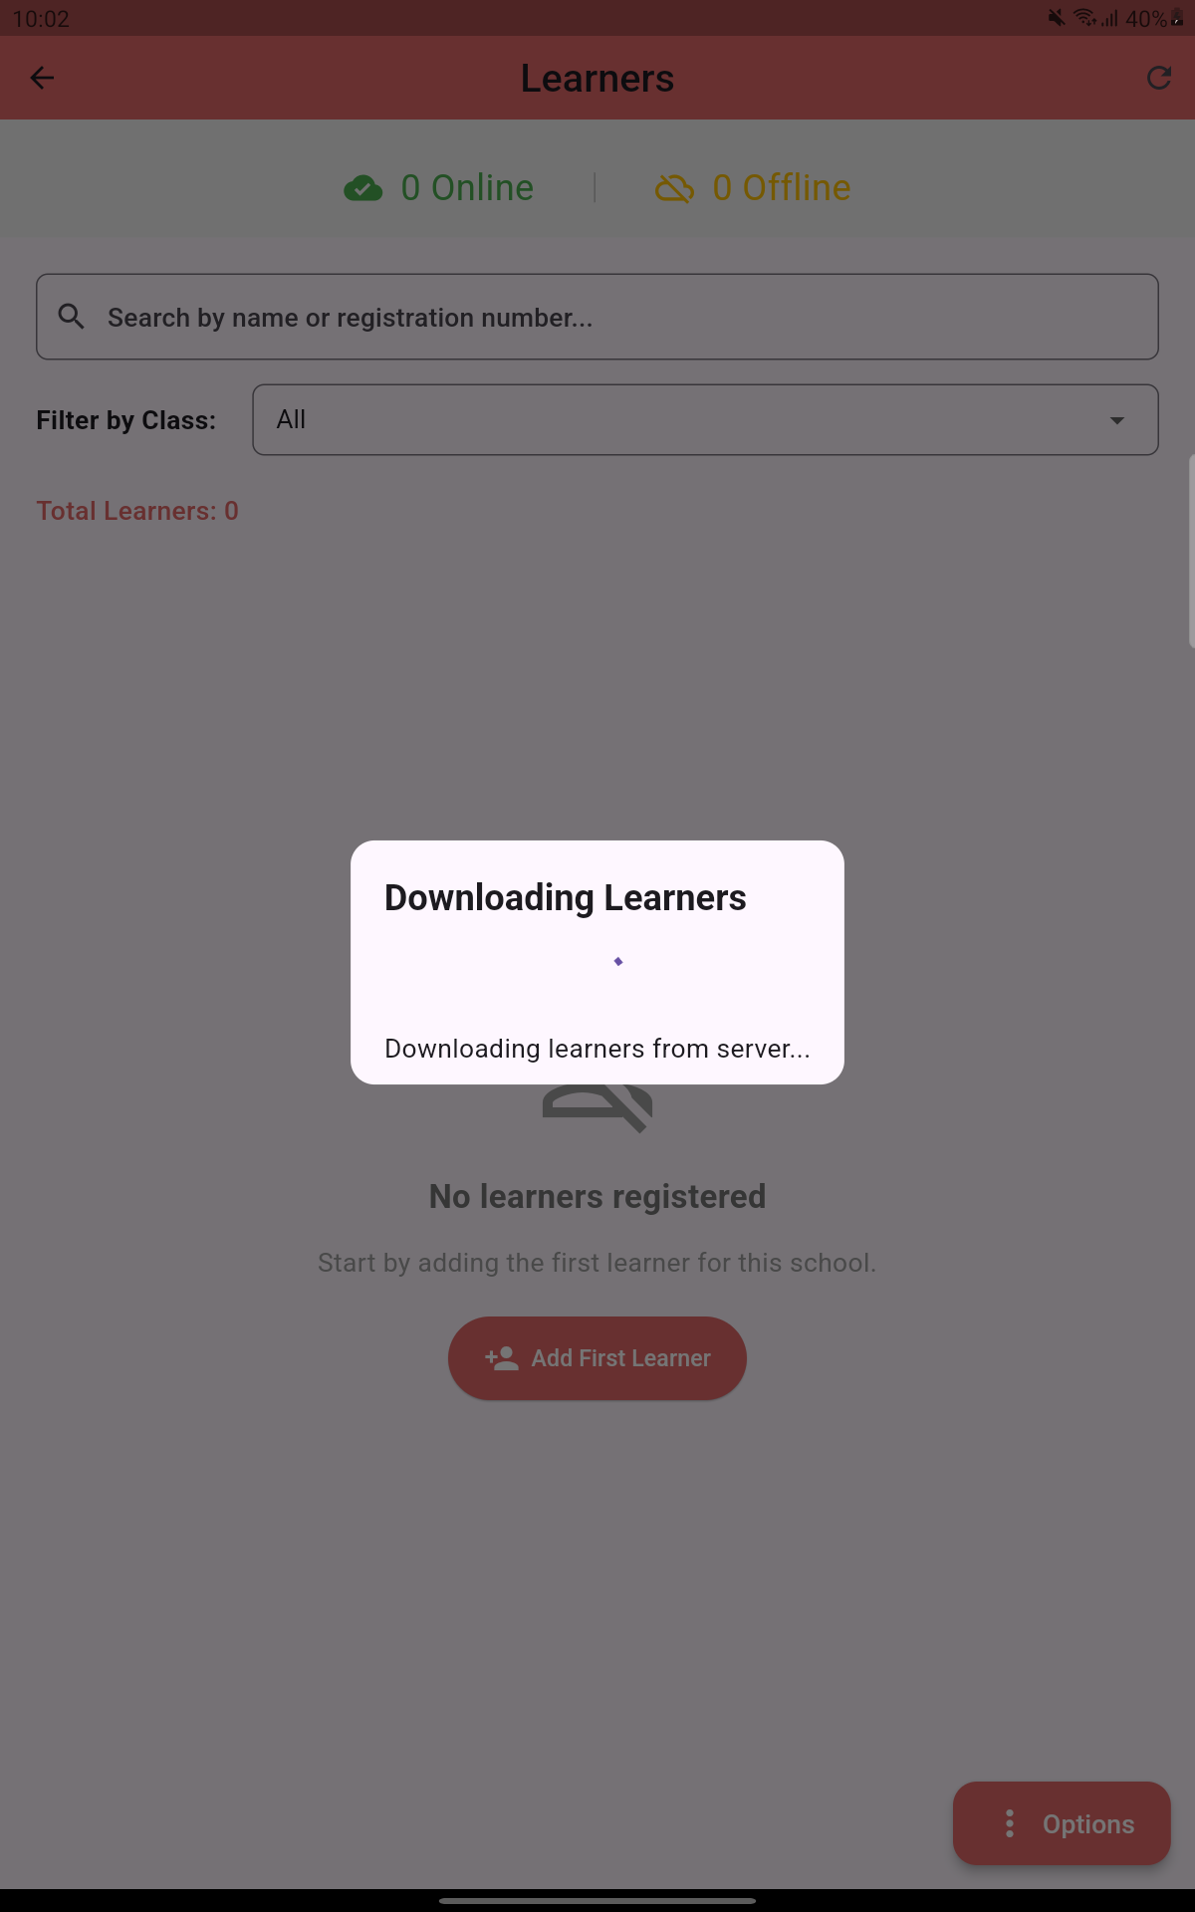
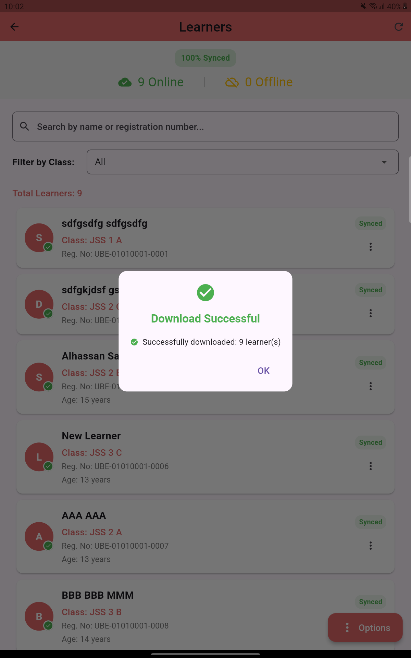
Click ‘Options’ then ‘Download Data’, then ‘Download’ to download already uploaded Learners.

Slide 35
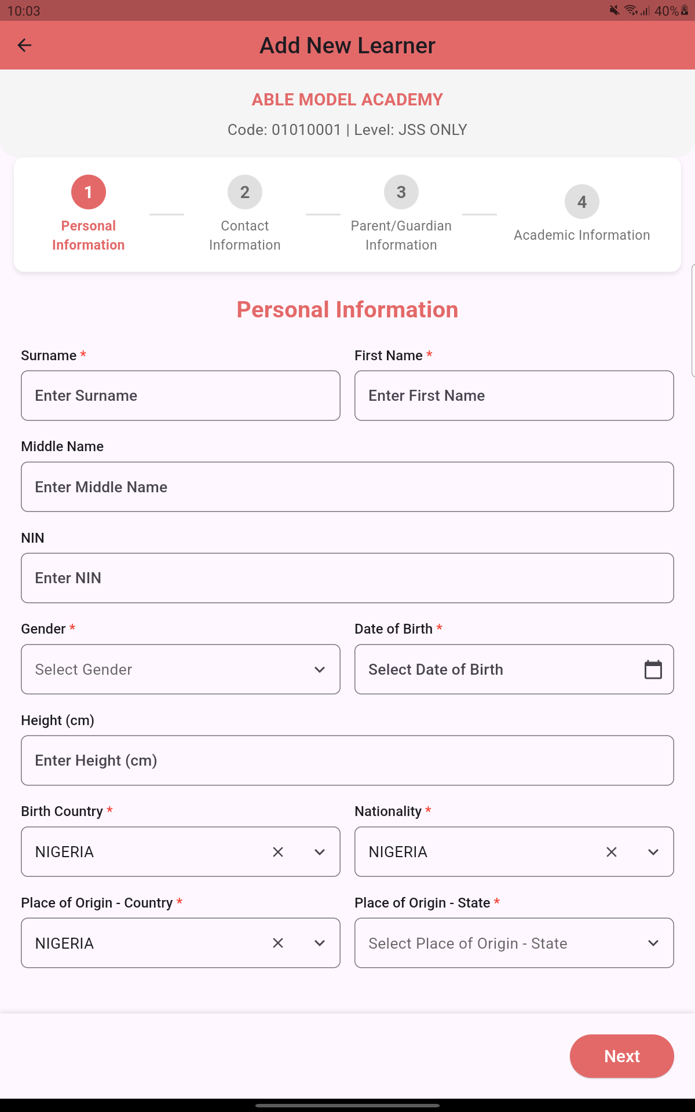

To add a learner, click ‘Options’ then ‘Add Learner’.
Fill the personal learner’s information and click ‘Next’ to proceed.
After filling the learner’s information, you can click on any learner to view the learner’s information.

Slide 36


TEACHERS MODULE
To add or update Teachers’ Information, click ‘Menu’ and then ‘Teachers’ icon
Click ‘Add First Teacher’ icon to add a learner or ‘Options’ then ‘Add Teacher’.
’
Click ‘Options’ then ‘Download Data’, then ‘Download’ to download already uploaded Teachers.

Slide 37



To add a new teacher, click ‘Options’ then ‘Add Teacher’, fill the teacher’s Information and click ‘Next’ to proceed. Click ‘Submit’ to submit the information.

Slide 38

Thank you!!!

